Slide 1


LEARNING
MATE
Learning
Management
System

Slide 2


INDEX
Learning Management System
Introduction and Roles
Planning and Purpose
Development Technical Stack
UX·UI Wireframes and Storyboard
Relational Data Modeling
Service Architecture
Core Sources
Project Demonstration
Q & A
1
2
3
4
5
6
7
8
9

Slide 3



Learning Management System
Introduction and Roles

Slide 4


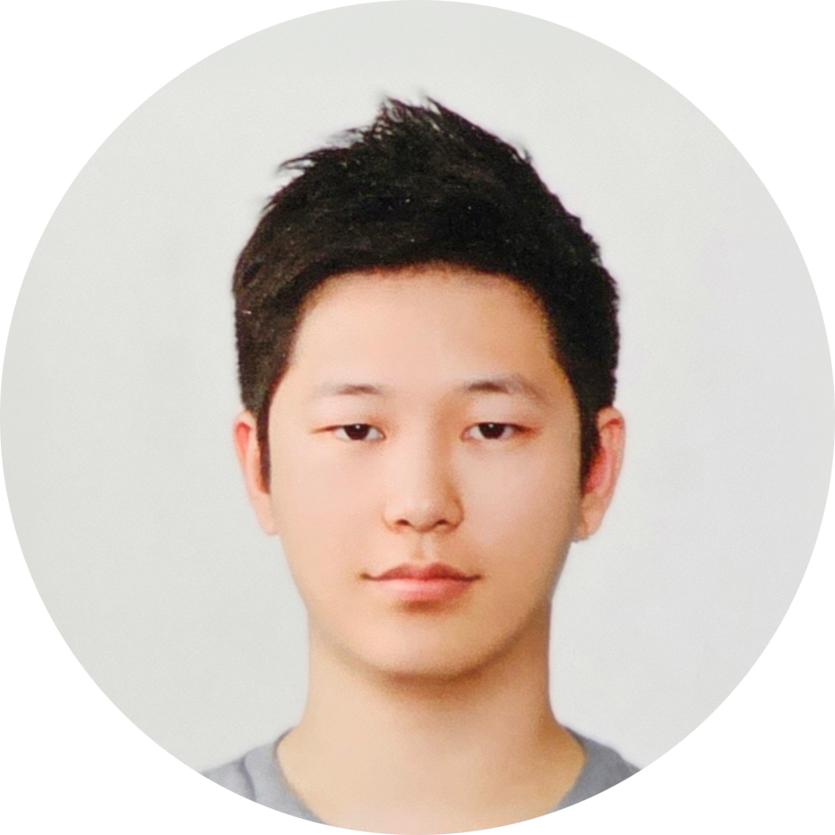

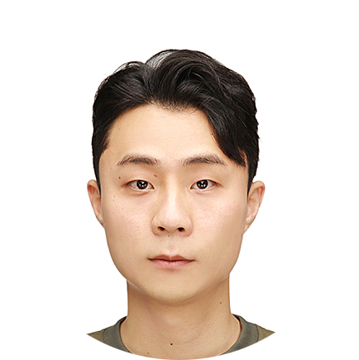


Learning Management System
INTRODUCTION AND ROLES
프론트엔드
신준철
오연주
김태영
팀장
Front-end 총괄
강사, 훈련생 관련 모든페이지 디자인 및 코딩 (List + CRUD기능)
Front-end와 Back-end 연동을 위한 요청코드 및 return 데이터 가공코드를 작성하여 화면에 출력
리액트 프로그램 활용한 LMS 프로그램 과정 조회, 등록 페이지 컴포넌트 제작 및 구현
CSS 기능을 바탕으로 한 프로그램 디자인 설계 및 제작
백엔드에서 보내주는 CRUD 데이터와 프론트 화면의 연동 구현
과정 상세 조회 페이지 설계 및 디자인

Slide 5

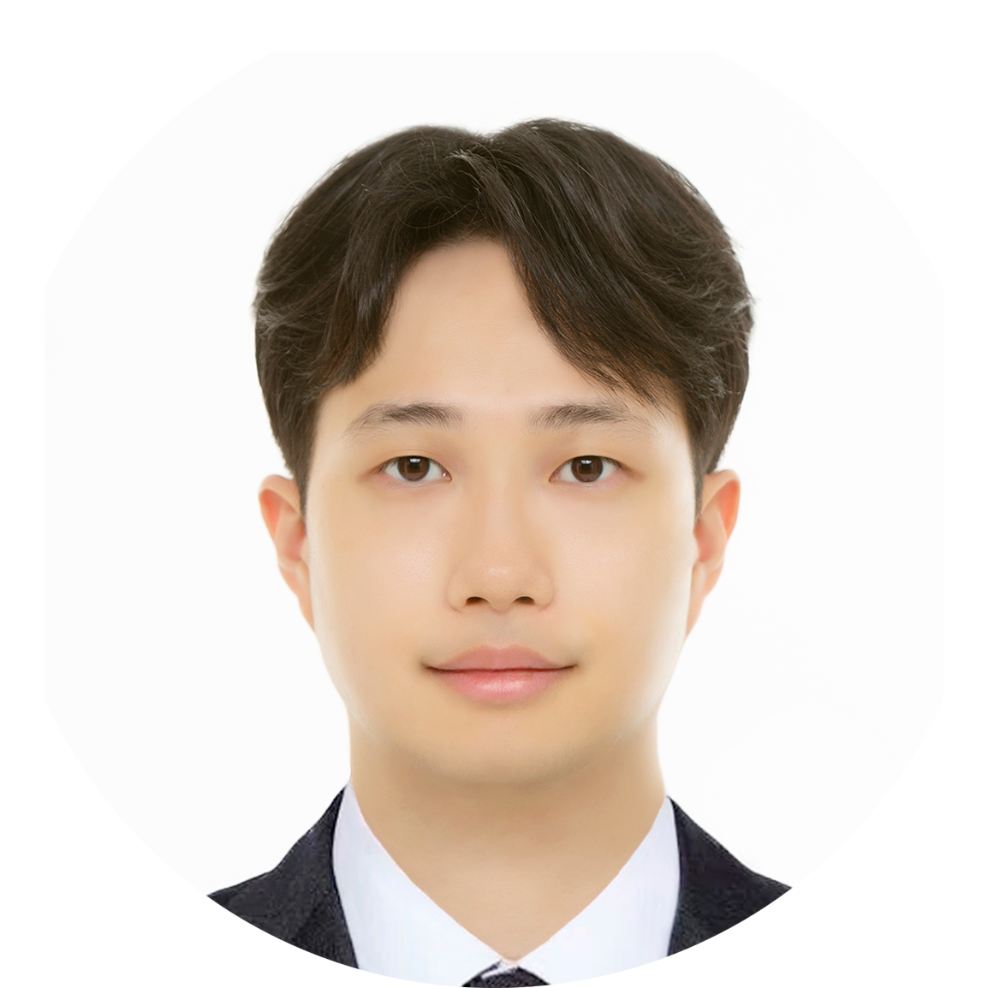
Learning Management System
INTRODUCTION AND ROLES
백엔드
윤성미
홍성태
테이블 매핑 Entity 구현
각 Service에 사용되는 데이터 처리 Repositories 및 QueryMethods 등 구현
각 기능 Tests 코드 작성 및 테스트
무한순환오류 해결
Instructor LIST + CRUD 및
Controller & Service 로직체계 구성
SpringBoot Security 를 활용한 Login 로직 구현 & Security 체계 구성

Slide 6
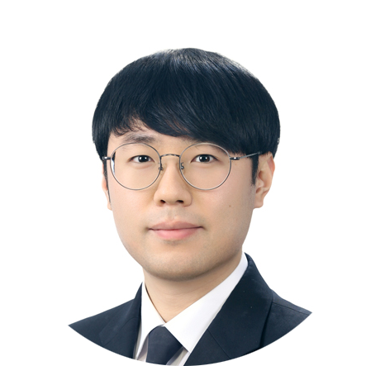
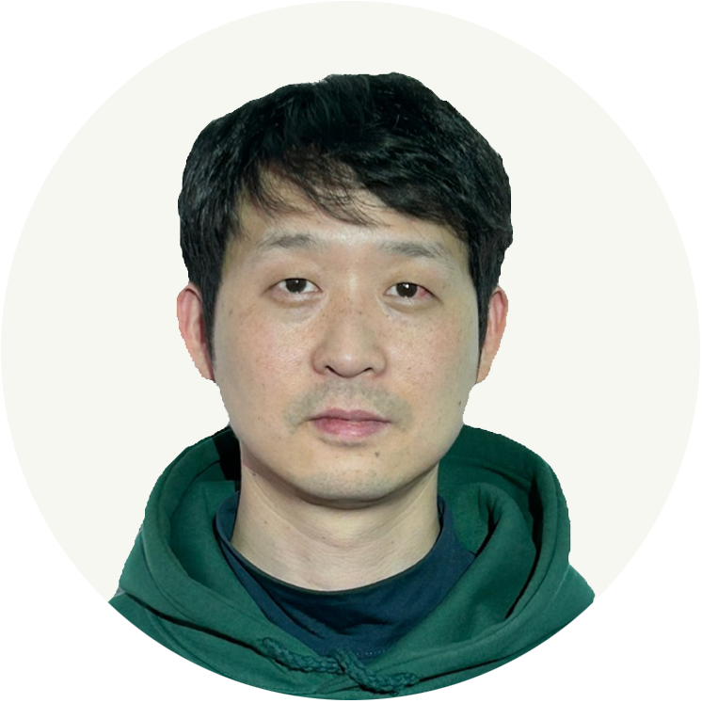
Learning Management System
INTRODUCTION AND ROLES
백엔드
최성락
소용서
Repository를 주입받아 과정 Service 계층 구현
과정 Controller의 LIST + CRUD 구현
프론트엔드와 백엔드의 파일 연동 및 업로드 기능 구현
훈련생 Controller의 LIST + CRUD를
RESTfull API로 구현
Slice를 활용한 페이징 구현

Slide 7
Learning Management System
Planning and Purposes

Slide 8



Learning Management System
PLANNING PURPOSE
세상에서
가장 쉬운
학습 관리 시스템
직관적인 구성
사용자가 빠르게 적응할 수 있는 시스템 구축
편리한 기능
최소한의 조작으로 기능 구현
효율적 운영
핵심기능에 집중하여 생산성 극대화
편리성
간소화
Convenience
Simplification
자동화
효율성
Automation
Efficiency

Slide 9
Learning Management System
Development Technical Stack

Slide 10







Learning Management System
Development Technical Stack
01. Package Management Tool
- scoop chore(release):
Bump to version 0.5.2 (#6080)
02. IDE (Integrated Development Environment)
- Eclipse for enterprise edition,
version 2025-03 with Spring Tools version 4.29.0 RELE
- MS Visual Source Code version 1.98.0
03. JDK (Java Development Kit)
- Amazon corretto11-jdk 11.0.26.4.1 (LTS)
- Amazon corretto17-jdk 17.0.14.7.1 (LTS)
- Amazon corretto21-jdk 21.0.6.7.1 (LTS) Main
04. JVM Analysis Tool
- Amazon JMC (Java Mission Control) version 8.1.1.1
- Open Source VisualVM version 2.1.10

Slide 11









Learning Management System
Development Technical Stack
05. RDBMS
(Relational DataBase Management Tools)
(1) On premise
- Apache H2 version 2.3.232
- MySQL version 8.4.4 (LTS)
- Oracle 19c Release 3
(2) Cloud - OCI (Oracle Cloud Infrastructure) PaaS
- Oracle21c ATP (Autonomous Transaction Processing)
06. Database Client Tool
(1) CLI
- Oracle SQL*Plus version 19.0.0.0.0
- MySQL Shell version 9.2.0
(2) GUI
- Oracle SQL*Developer 24.3.1.347
- MySQL Workbench version 8.0.41
- Visual Source Code with Oracle SQL Developer Extension version 24.4.1
- Visual Source Code with MySQL Shell for VS Code version 1.19.2+9.2.0
- Dbeaver Community Edition version 25.0.0

Slide 12
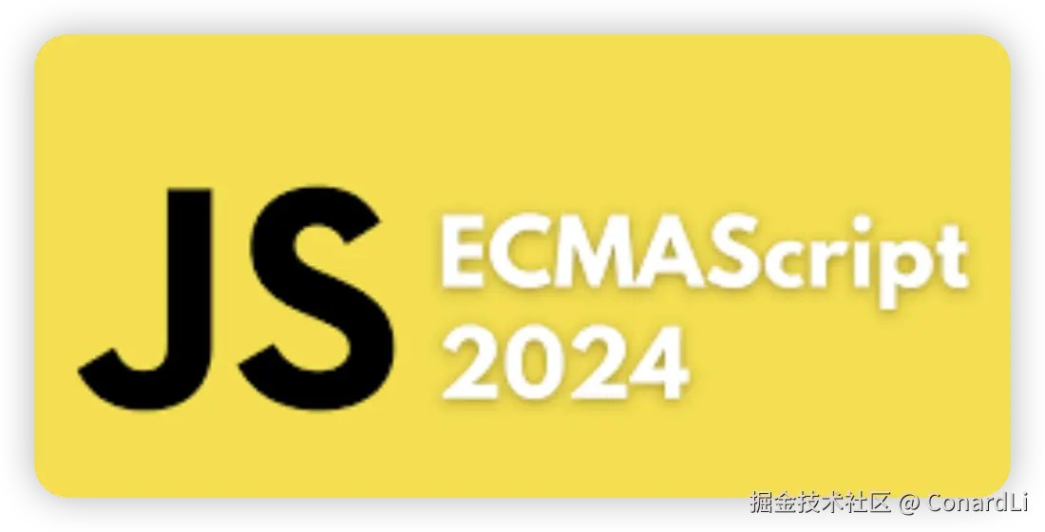






Learning Management System
Development Technical Stack
07. Program Languages
(1) Front-End
- ECMAScript 2024 (ES6+)
- Vanila Script (ES5)
- HTML5, CSS3
(2) Back-End
- JAVA 11/17/21 (Main: 21)
- JShell version 21.0.6
08. Project Build Tools
- Apache Maven version 3.9.9
- Open source Gradle-Groovy version 8.12.1
09. Programming Tools
(1) Platforms
- Microsoft Windows 10 version 22H2
- NodeJS version 23.8.0 (LTS) with npm version 23.8.0, npx version 11.1.0

Slide 13














Learning Management System
Development Technical Stack
09. Programming Tools
...
(2) CLI Tools
- Windows Terminal version 1.21.10351.0
- PowerShell version 7.5.0
- Netcat version 1.12
- nvm (Node Version Manager) version 1.2.2
- MS Sysinternals version 20250213
- gow unix commands for windows version 0.8.0
(3) GUI Tools
- Sublime-text version 4-4186
- 7zip version 24.09
- Postman version 3.10.11
- Visual Source Code with Postman Extension version 1.8.1
- Visual Source Code with REST Client Extension version 0.25.1
- Spring Initializr
(4) Web Browser (Cross Browsing Test)
- Microsoft Edge, Google Chrome, Mozilla Firefox

Slide 14





Learning Management System
Development Technical Stack
10. SCM Tools
(1) CLI
- gh (GitHub) version 2.68.1
- git version 2.48.1
- gitignore version 3.4.17
(2) GUI
- GitHub Desktop Client version 3.4.17
- Visual Source Code Integrated git with Git Graph Extension version 1.30.0
- Eclipse Integrated Git (m2e)
- Intellij IDEA Integrated Git
(3) Remote Repositories
- github.com
- Team Development
11. Main Frameworks & Core Libraries
(1) Front-End
- React version 19.9.0

Slide 15








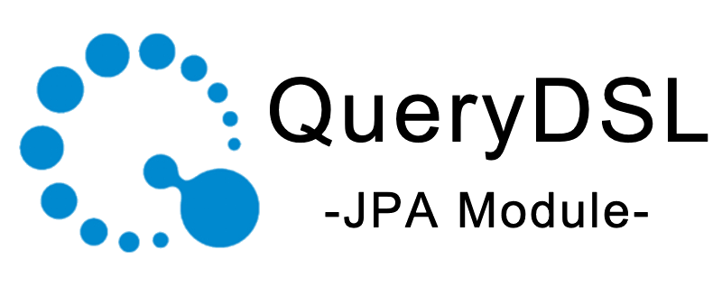
Learning Management System
Development Technical Stack
11. Main Frameworks & Core Libraries
...
- Bootstrap version 5.3.3
- JQuery version 3.7.1
- JQuery-migrate version 3.5.2
(2) Back-End
- Spring Boot version 3.4.3 Latest
- Spring MVC Framework version 3.4.3
- Lombok plugin & library version 1.18.36
- Apache MyBatis SQL Mapper Framework version 3.5.19
- Spring bridge for MyBatis sql mapping framework version 3.0.4
- Spring JDBC / Spring Data / Spring Data JDBC
- Standard Java Persistence API version 3.1.0
- Spring Data JPA version 3.4.3
- Spring Data JPA QueryDSL version 3.4.3
- Spring Security Framework version 6.4.3

Slide 16








Learning Management System
Development Technical Stack
11. Main Frameworks & Libraries
...
- Hibernate JPA ORM framework version 6.6.8.FINAL
- Standard JEE Servlet version 6.0, JSP version 3.1, JSTL version 3.0.1
- Spring-Thymeleaf Template Engine version 3.1.3.RELEASE
- Quartz Job Scheduler Framework version 2.5.0
- Spring-Quartz Bridge Library version 3.4.3
- UUID type 1, 3, 4, 5 Generation Library
- BCrypt (SHA-256) Password Encoder
(3) Test Frameworks
- JUnit Jupyter Test Framework version 5.11.4
(4) JDBC Driver
- H2 version 2.232
- mysql-connector/J version 9.1.0
- Oracle ojdbc11 on premise
- Oracle ojdbc11-production for OCI (Oracle Cloud)

Slide 17




Learning Management System
Development Technical Stack
12. Servers
(1) Web Server
- Nginx version 1.27.4
- Apache Tomcat version 9.0.102
- npm serve version 14.2.4
(2) Web Application Server (WAS)
- Apache Tomcat version 10.1.39
- Apache Tomcat version 9.0.102
- Spring Boot Embedded Tomcat version 10.1.36
13. Team Collaborative Tools
(1) Kakaotalk
(2) Figma

Slide 18
Learning Management System
UX·UI Wireframes and StoryBoard

Slide 19
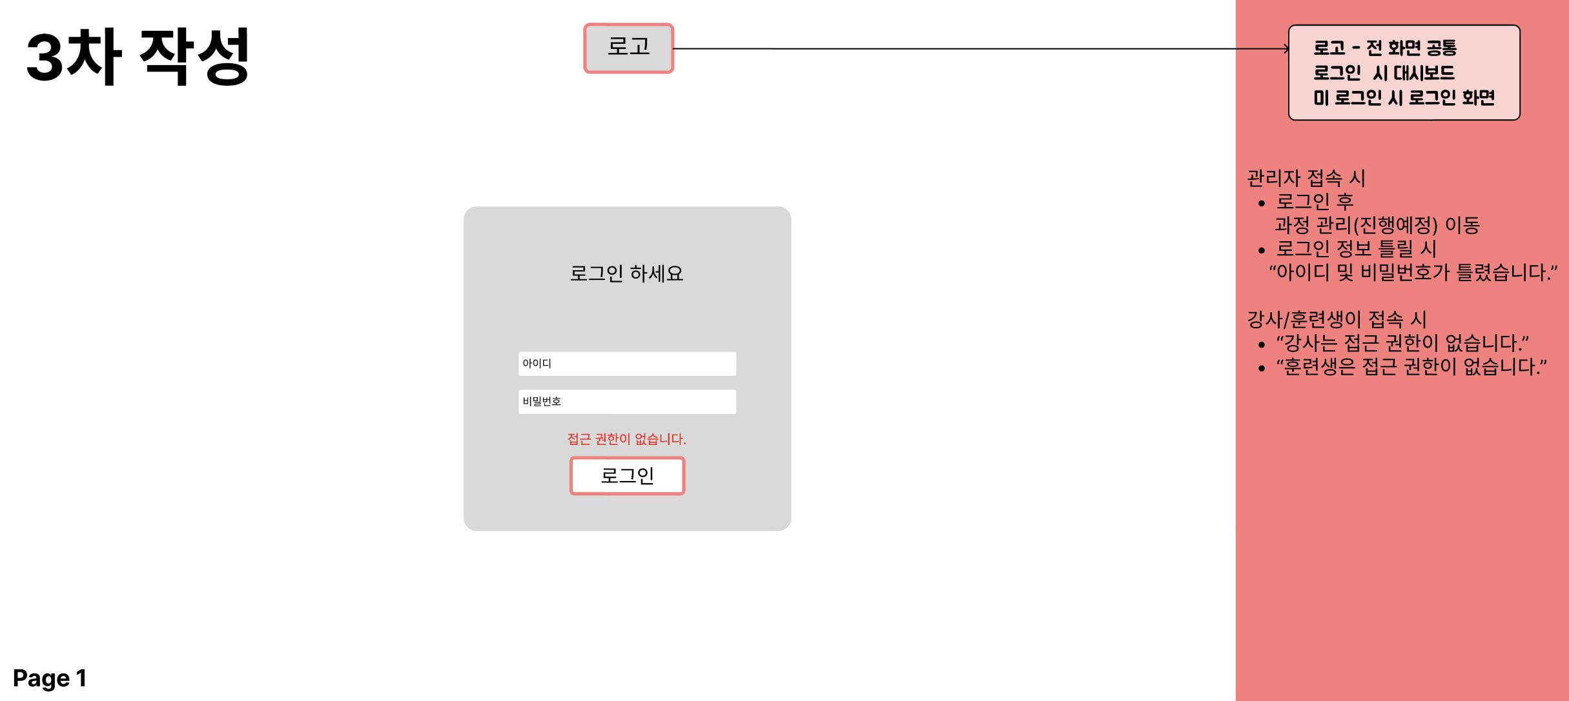
Learning Management System
UX·UI Wireframes and Story Board
4-1. Wireframes

Slide 20
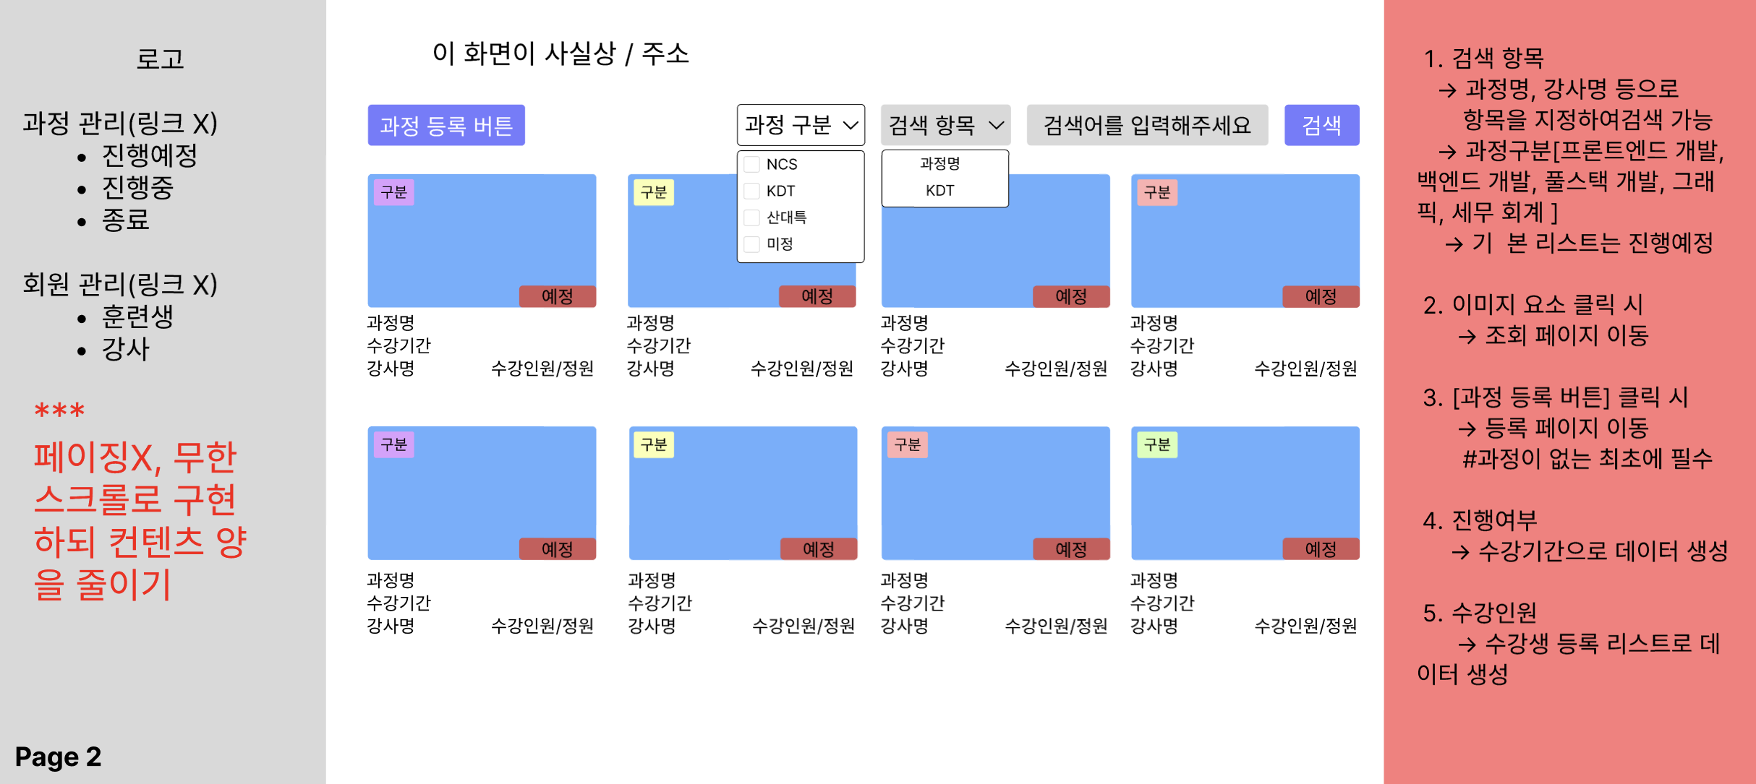
Learning Management System
UX·UI Wireframes and Story Board
4-1. Wireframes

Slide 21
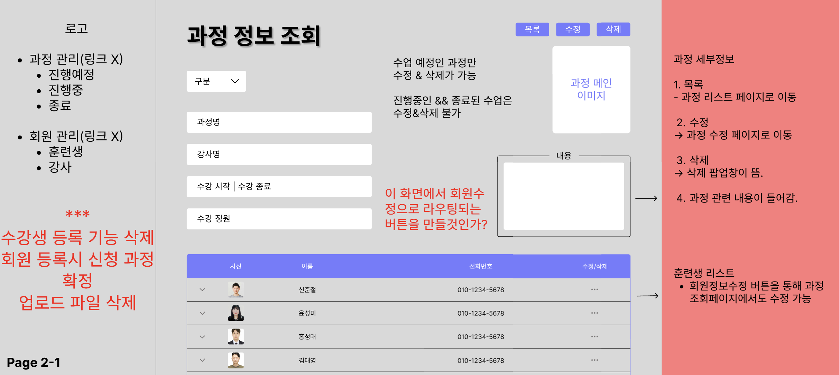
Learning Management System
UX·UI Wireframes and Story Board
4-1. Wireframes

Slide 22
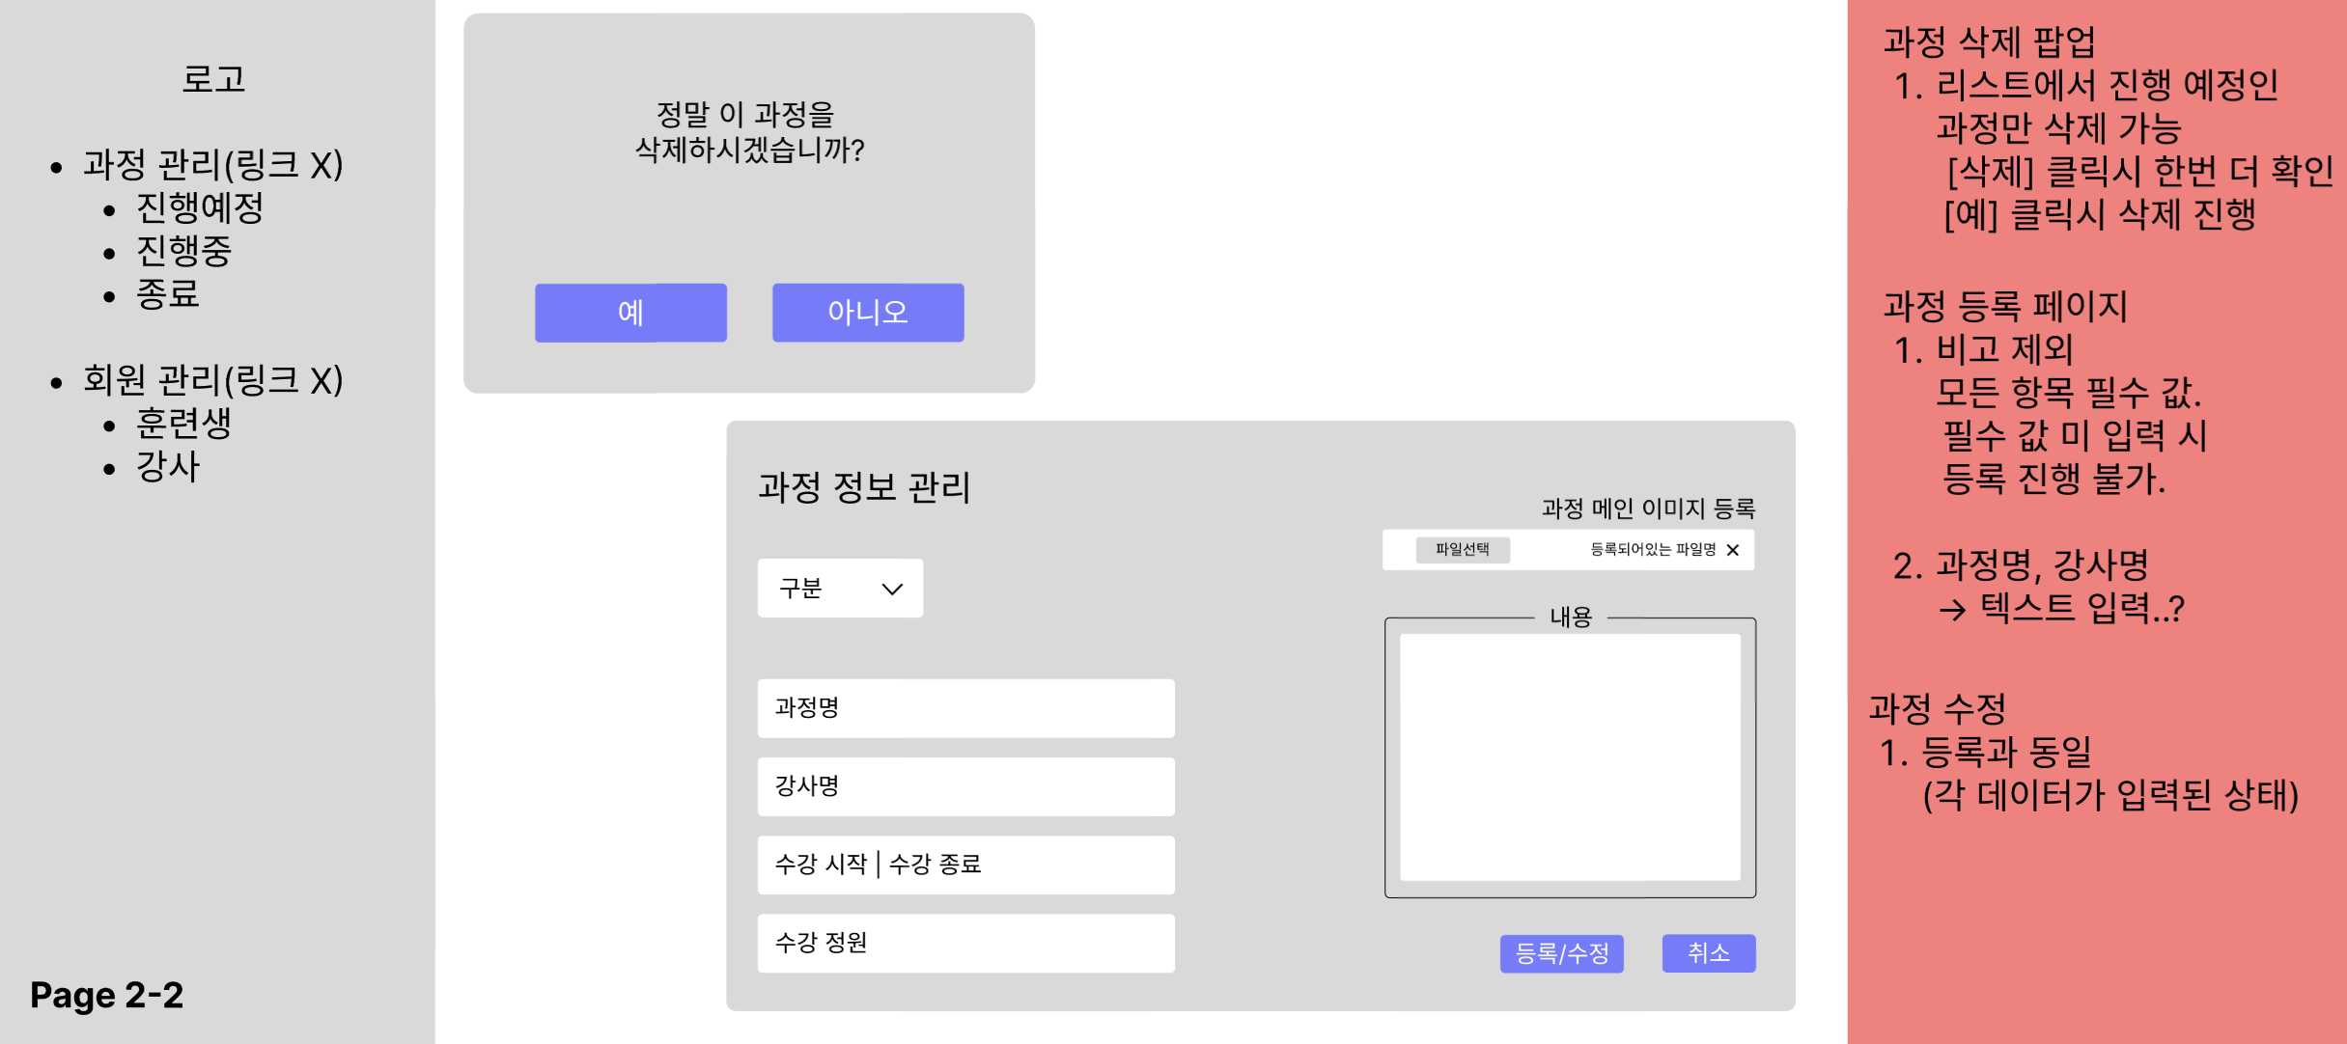
Learning Management System
UX·UI Wireframes and Story Board
4-1. Wireframes

Slide 23
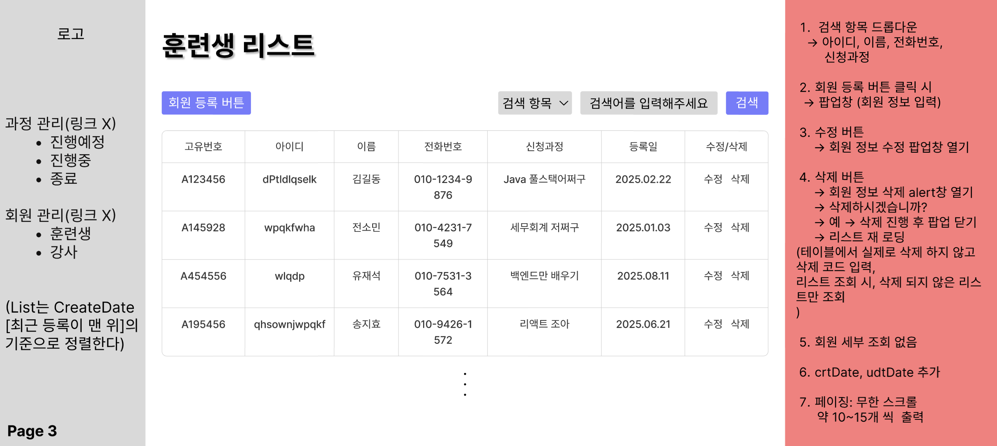
Learning Management System
4-1. Wireframes

Slide 24
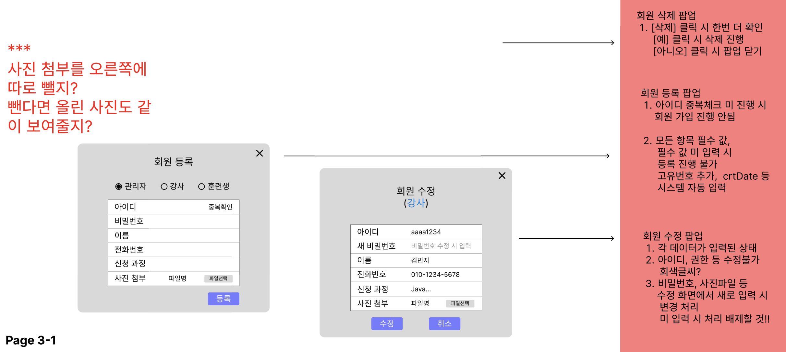
Learning Management System
UX·UI Wireframes and Story Board
4-1. Wireframes

Slide 25
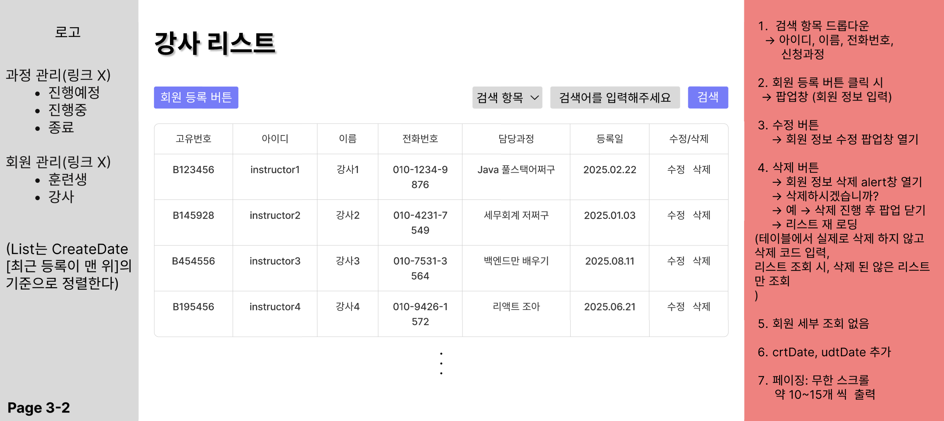
Learning Management System
UX·UI Wireframes and Story Board
4-1. Wireframes

Slide 26
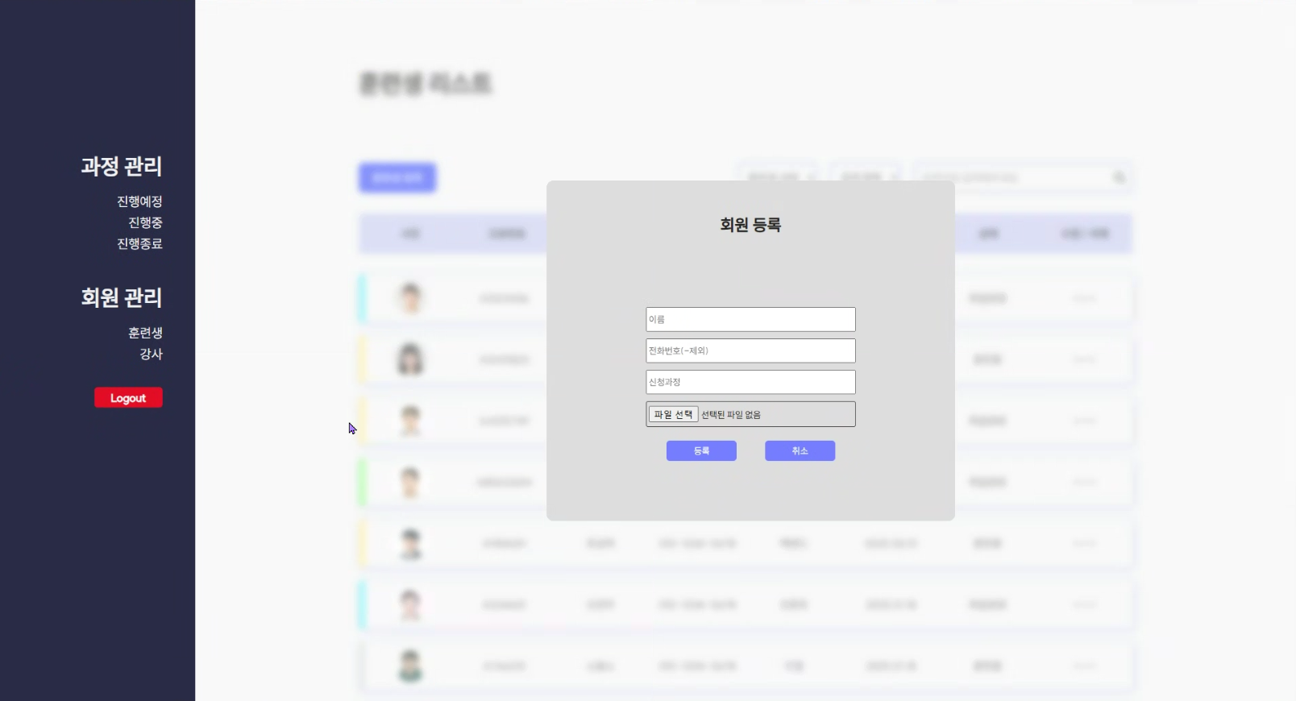
Learning Management System
UX·UI Wireframes and Story Board
4-2. Storyboard

Slide 27
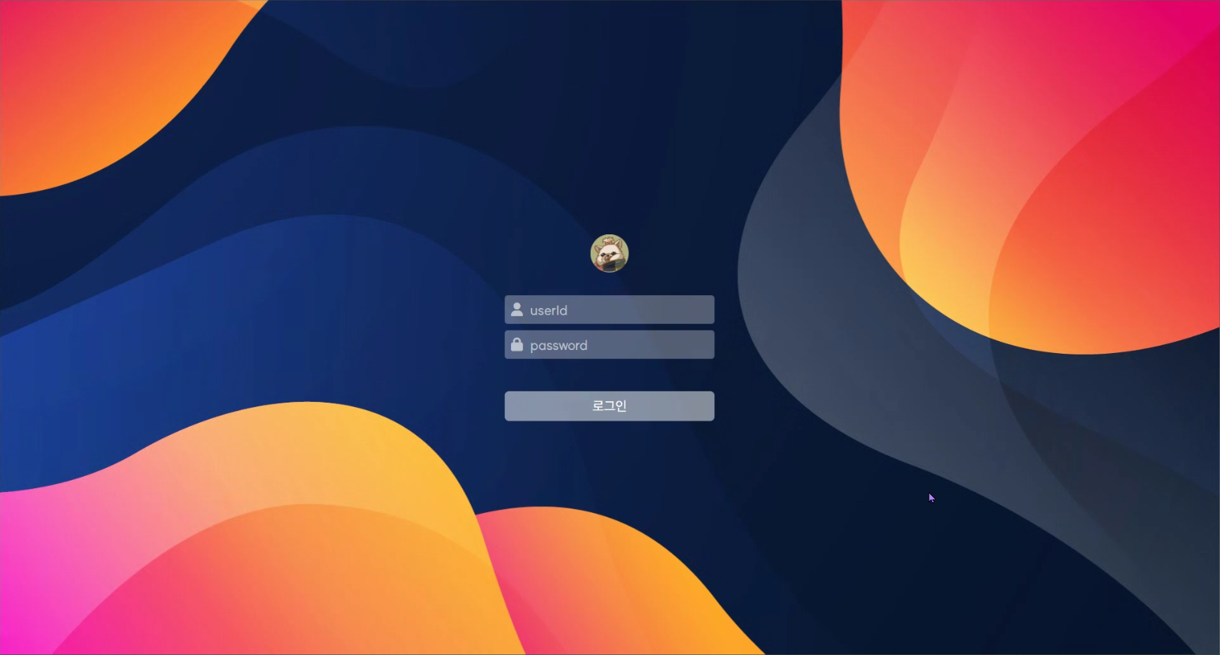
Learning Management System
UX·UI Wireframes and Story Board
4-2. Storyboard

Slide 28
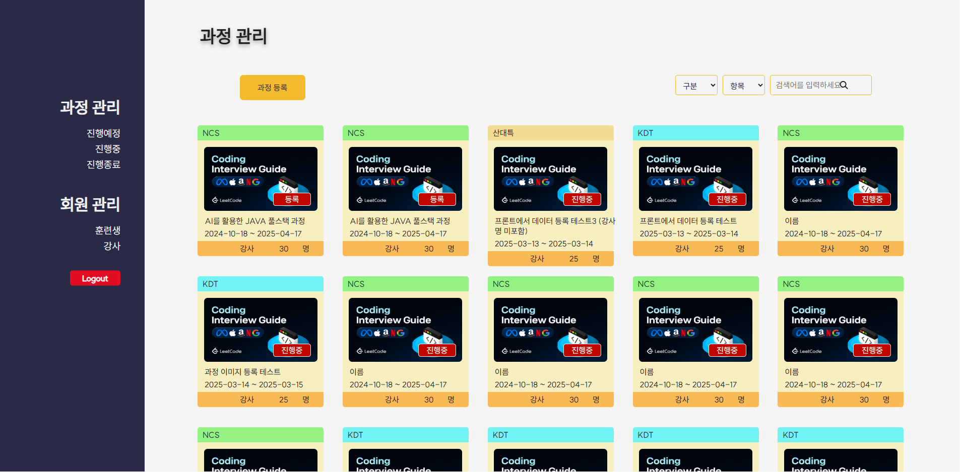
Learning Management System
UX·UI Wireframes and Story Board
4-2. Storyboard

Slide 29
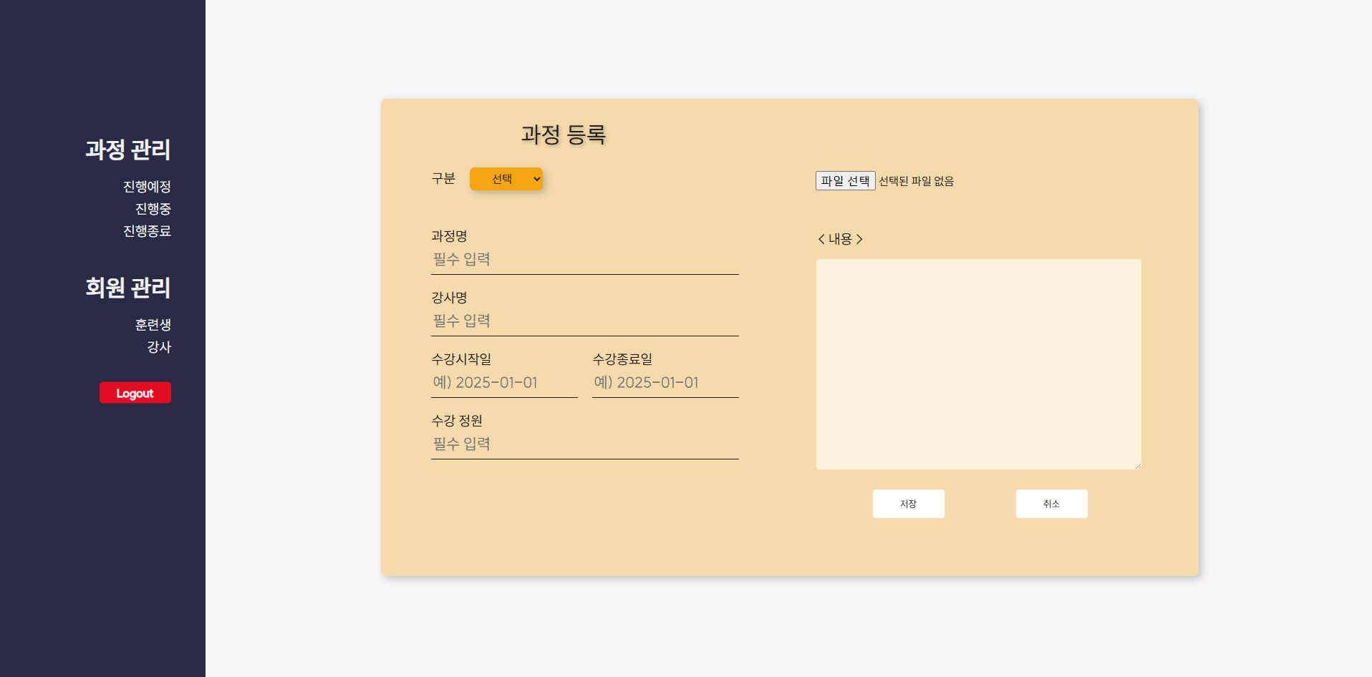
Learning Management System
UX·UI Wireframes and Story Board
4-2. Storyboard

Slide 30
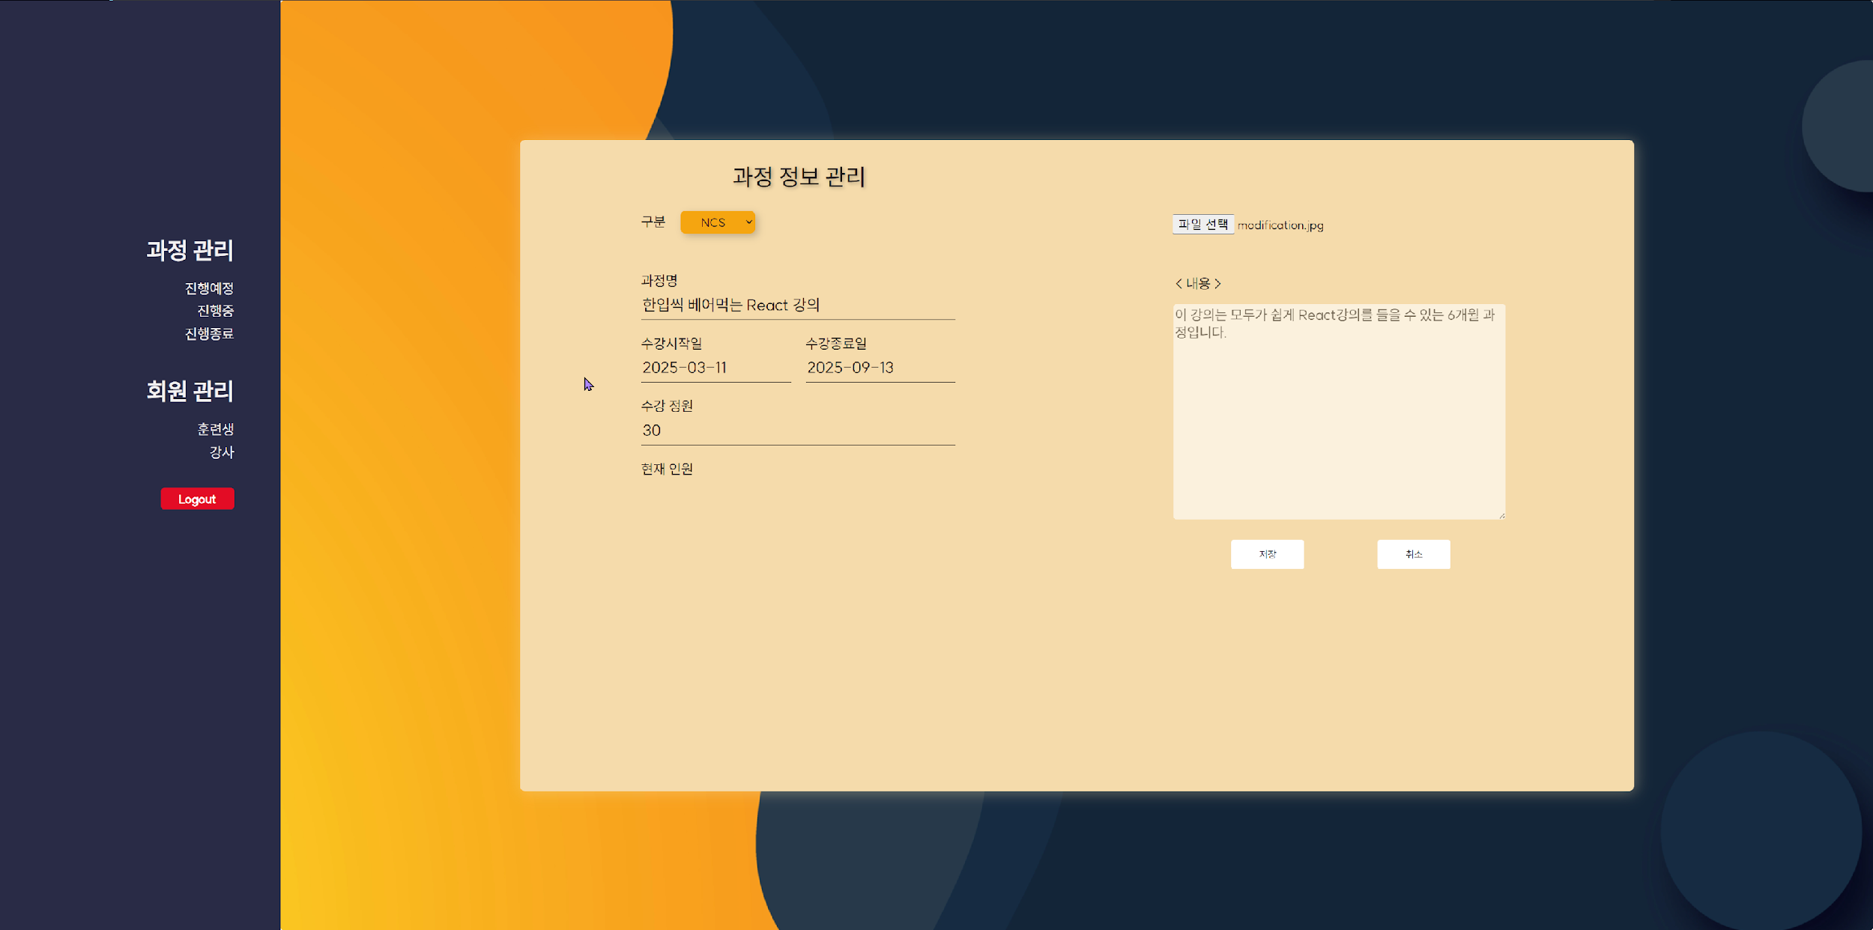
Learning Management System
UX·UI Wireframes and Story Board
4-2. Storyboard

Slide 31
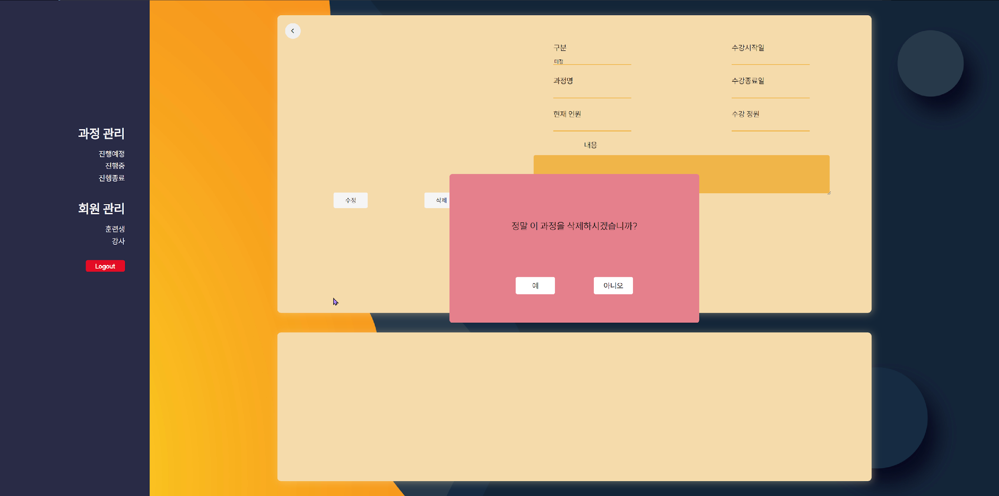
Learning Management System
UX·UI Wireframes and Story Board
4-2. Storyboard

Slide 32
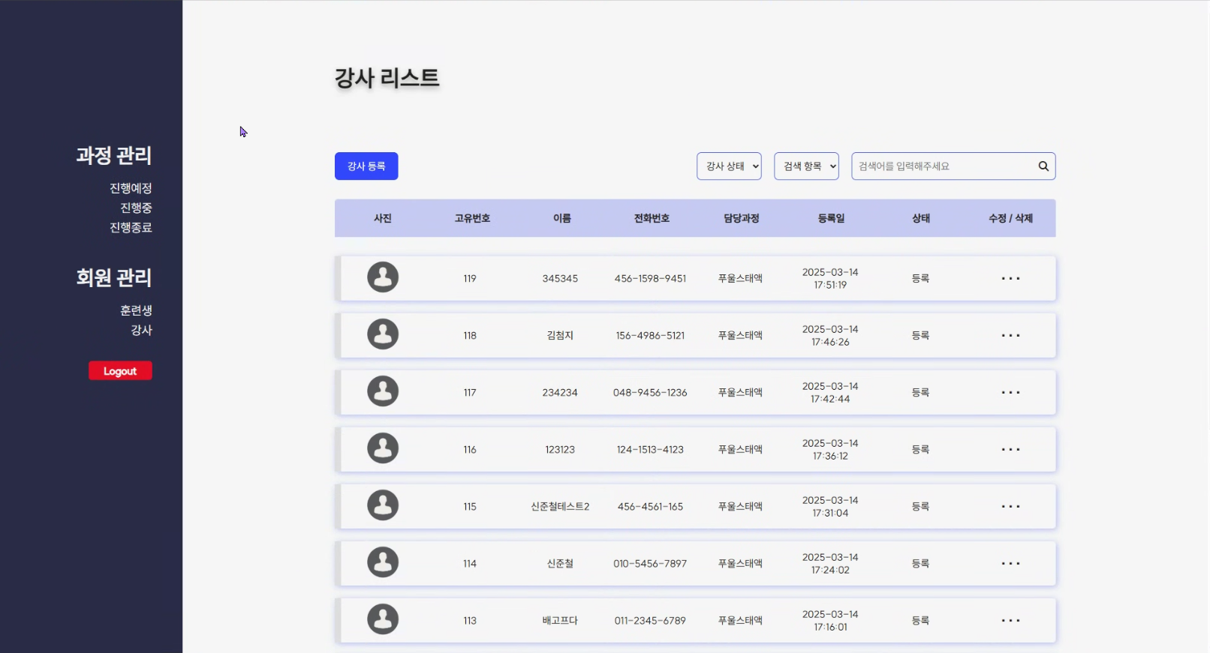
Learning Management System
UX·UI Wireframes and Story Board
4-2. Storyboard

Slide 33
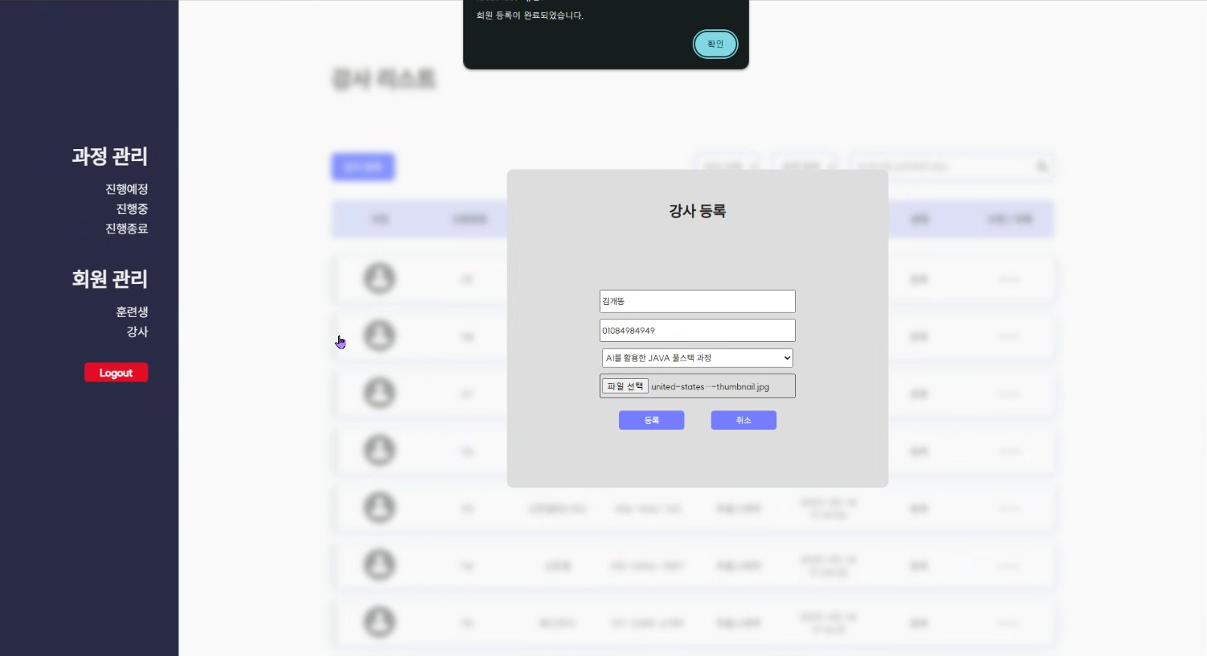
Learning Management System
UX·UI Wireframes and Story Board
4-2. Storyboard

Slide 34
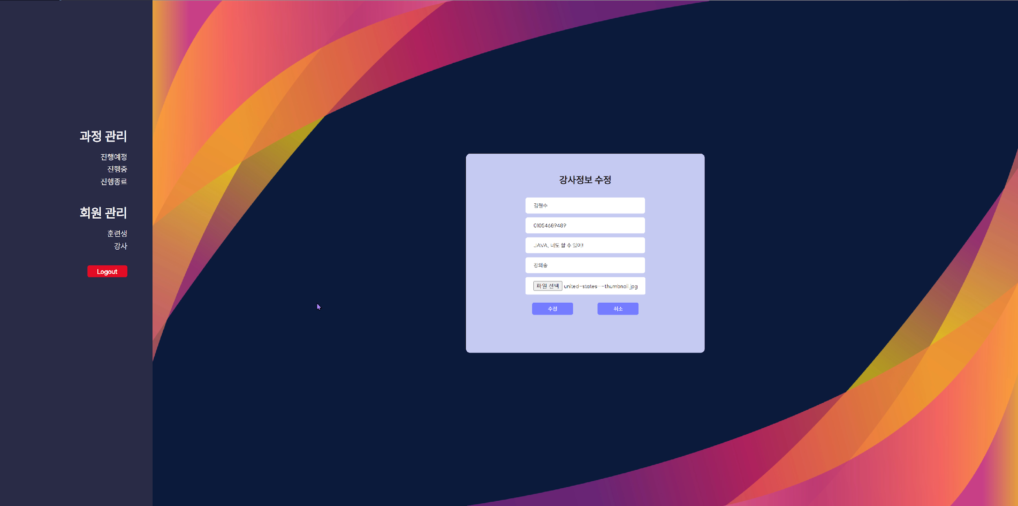
Learning Management System
UX·UI Wireframes and Story Board
4-2. Storyboard

Slide 35
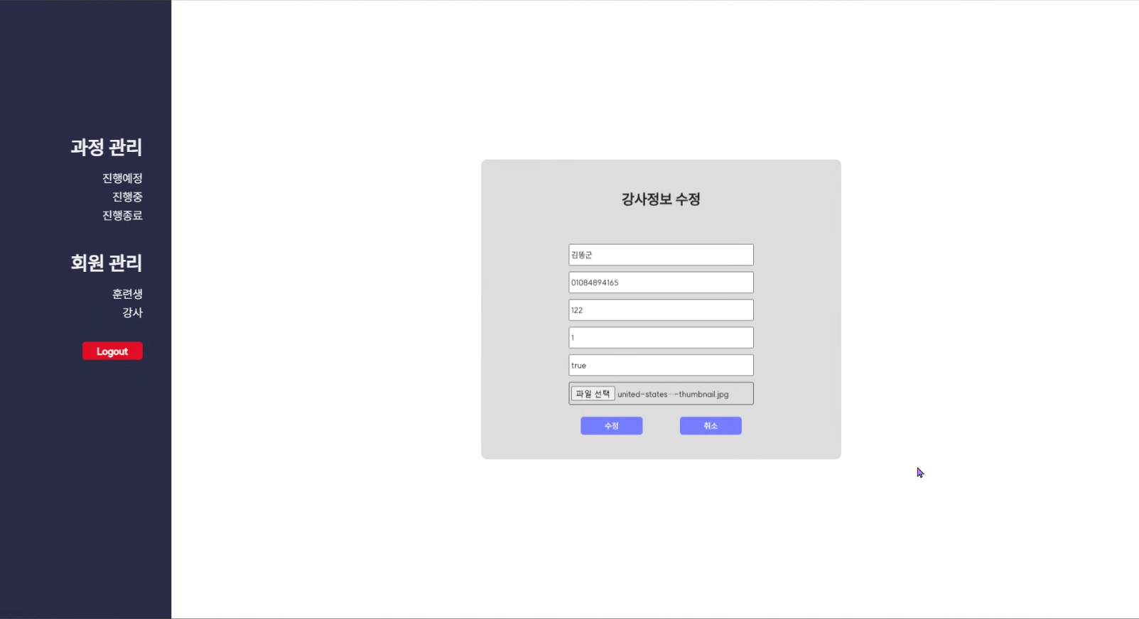
Learning Management System
UX·UI Wireframes and Story Board
4-2. Storyboard

Slide 36

Learning Management System
UX·UI Wireframes and Story Board
4-2. Storyboard

Slide 37

Learning Management System
UX·UI Wireframes and Story Board
4-2. Storyboard

Slide 38
Learning Management System
Relational Data Modeling

Slide 39
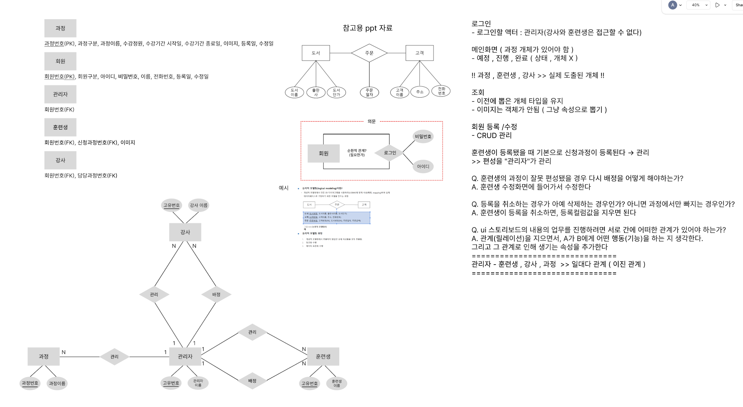
Learning Management System
Relational Data Modeling
5-1. ERD

Slide 40
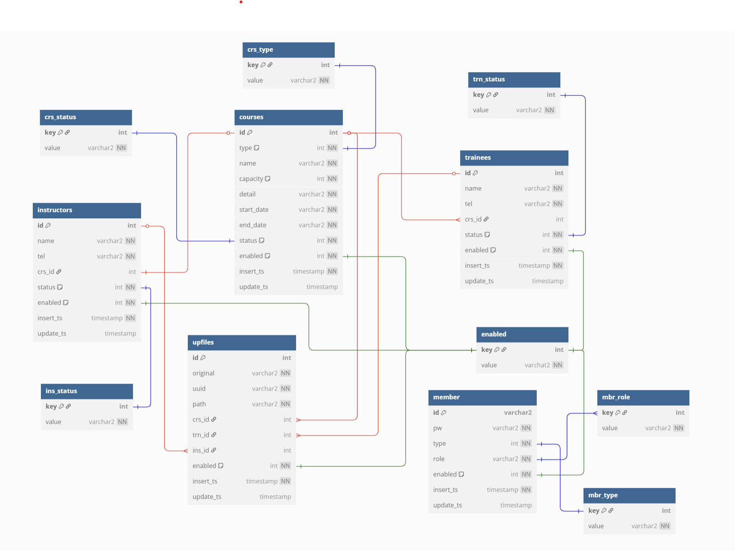
Learning Management System
Relational Data Modeling
5-2. Logical Model

Slide 41
Learning Management System
Relational Data Modeling
5-3. DDL-1
CREATE TABLE t_courses (
id SMALLINT
GENERATED BY DEFAULT ON NULL AS IDENTITY (
START WITH 1 INCREMENT BY 1 NOCACHE
)
CONSTRAINT t_courses_pk PRIMARY KEY,
type VARCHAR2(255) NOT NULL,
name VARCHAR2(500) NOT NULL,
capacity SMALLINT DEFAULT 0 NOT NULL,
detail VARCHAR2(4000) NOT NULL,
start_date VARCHAR2(50) NOT NULL,
end_date VARCHAR2(50) NOT NULL,
status NUMBER(1,0) DEFAULT 1 CHECK(status IN(1, 2, 3, 4)) NOT NULL,
enabled NUMBER(1,0) DEFAULT 1 NOT NULL CHECK(enabled IN(1, 0)),
insert_ts DATE DEFAULT current_date NOT NULL,
update_ts DATE
);

Slide 42
Learning Management System
Relational Data Modeling
5-3. DDL-2
COMMENT ON TABLE t_courses IS '과정';
COMMENT ON COLUMN t_courses.id IS '과정번호';
COMMENT ON COLUMN t_courses.type IS '과정구분';
COMMENT ON COLUMN t_courses.name IS '과정이름';
COMMENT ON COLUMN t_courses.capacity IS '수강정원';
COMMENT ON COLUMN t_courses.detail IS '내용';
COMMENT ON COLUMN t_courses.start_date IS '시작일';
COMMENT ON COLUMN t_courses.end_date IS '종료일';
COMMENT ON COLUMN t_courses.status IS '상태(등록=1,진행중=2,폐지=3,종료=4)';
COMMENT ON COLUMN t_courses.enabled IS '삭제여부(1=유효,0=삭제)';
COMMENT ON COLUMN t_courses.insert_ts IS '최초등록일';
COMMENT ON COLUMN t_courses.update_ts IS '최종수정일';

Slide 43
Learning Management System
Relational Data Modeling
5-3. DDL-3
CREATE TABLE t_instructors (
id SMALLINT
GENERATED BY DEFAULT ON NULL AS IDENTITY (
START WITH 1 INCREMENT BY 1 NOCACHE
)
CONSTRAINT t_instructors_pk PRIMARY KEY,
name VARCHAR2(100) NOT NULL,
tel VARCHAR2(50) NOT NULL,
crs_id SMALLINT
CONSTRAINT t_instructors_crs_id_fk
REFERENCES t_courses(id) ON DELETE CASCADE,
status NUMBER(1,0) DEFAULT 1 CHECK(status IN(1, 2, 3)) NOT NULL,
enabled NUMBER(1,0) DEFAULT 1 NOT NULL CHECK(enabled IN(1, 0)),
insert_ts DATE DEFAULT current_date NOT NULL,
update_ts DATE
);

Slide 44
Learning Management System
Relational Data Modeling
5-3. DDL-4
COMMENT ON TABLE t_instructors IS '강사';
COMMENT ON COLUMN t_instructors.id IS '아이디';
COMMENT ON COLUMN t_instructors.tel IS '전화번호';
COMMENT ON COLUMN t_instructors.name IS '이름';
COMMENT ON COLUMN t_instructors.crs_id IS '소속과정번호(FK)';
COMMENT ON COLUMN t_instructors.status IS '상태(등록=1,강의중=2,퇴사=3)';
COMMENT ON COLUMN t_instructors.enabled IS '삭제여부(1=유효,0=삭제)';
COMMENT ON COLUMN t_instructors.insert_ts IS '최초등록일';
COMMENT ON COLUMN t_instructors.update_ts IS '최종수정일';

Slide 45
Learning Management System
Relational Data Modeling
5-3. DDL-5
CREATE TABLE t_trainees (
id SMALLINT
GENERATED BY DEFAULT ON NULL AS IDENTITY (
START WITH 1 INCREMENT BY 1 NOCACHE
)
CONSTRAINT t_trainees_pk PRIMARY KEY,
name VARCHAR2(100) NOT NULL,
tel VARCHAR2(50) NOT NULL,
crs_id SMALLINT
CONSTRAINT t_trainees_fk
REFERENCES t_courses(id) ON DELETE CASCADE,
status NUMBER(1,0) CHECK(status IN(1, 2, 3, 4)) NOT NULL,
enabled NUMBER(1,0) DEFAULT 1 NOT NULL CHECK(enabled IN(1, 0)),
insert_ts DATE DEFAULT current_date NOT NULL,
update_ts DATE
);

Slide 46
Learning Management System
Relational Data Modeling
5-3. DDL-6
COMMENT ON TABLE t_trainees IS '훈련생';
COMMENT ON COLUMN t_trainees.id IS '아이디';
COMMENT ON COLUMN t_trainees.name IS '이름';
COMMENT ON COLUMN t_trainees.tel IS '전화번호';
COMMENT ON COLUMN t_trainees.crs_id IS '소속과정번호(FK)';
COMMENT ON COLUMN t_trainees.status IS '상태(훈련중=1,중도탈락=2,중도포기=3,취업완료=4)';
COMMENT ON COLUMN t_trainees.enabled IS '삭제여부(1=유효,0=삭제된데이터)';
COMMENT ON COLUMN t_trainees.insert_ts IS '최초등록일';
COMMENT ON COLUMN t_trainees.insert_ts IS '최종수정일';

Slide 47
Learning Management System
Relational Data Modeling
5-3. DDL-7
CREATE TABLE t_upfiles (
id SMALLINT
GENERATED BY DEFAULT ON NULL AS IDENTITY (
START WITH 1 INCREMENT BY 1 NOCACHE
)
CONSTRAINT t_upfiles_pk PRIMARY KEY,
original VARCHAR2(255) NOT NULL,
uuid VARCHAR2(255) NOT NULL,
path VARCHAR2(500) NOT NULL,
crs_id SMALLINT
CONSTRAINT t_upfiles_fk1
REFERENCES t_courses(id) ON DELETE CASCADE,
trn_id SMALLINT
CONSTRAINT t_upfiles_fk2
REFERENCES t_trainees(id) ON DELETE CASCADE,
ins_id SMALLINT
CONSTRAINT t_upfiles_fk3
REFERENCES t_instructors(id) ON DELETE CASCADE,
enabled NUMBER(1,0) DEFAULT 1 NOT NULL CHECK(enabled IN(1, 0)),
insert_ts DATE DEFAULT current_date NOT NULL,
update_ts DATE
);

Slide 48
Learning Management System
Relational Data Modeling
5-3. DDL-8
COMMENT ON TABLE t_upfiles IS '업로드파일';
COMMENT ON COLUMN t_upfiles.id IS '아이디';
COMMENT ON COLUMN t_upfiles.original IS '원본파일명';
COMMENT ON COLUMN t_upfiles.uuid IS '저장파일명';
COMMENT ON COLUMN t_upfiles.path IS '저장경로';
COMMENT ON COLUMN t_upfiles.crs_id IS '소속과정아이디(FK)';
COMMENT ON COLUMN t_upfiles.ins_id IS '소속강사아이디(FK)';
COMMENT ON COLUMN t_upfiles.trn_id IS '소속훈련생아이디(FK)';
COMMENT ON COLUMN t_upfiles.enabled IS '삭제여부(1=유효,0=삭제된데이터)';
COMMENT ON COLUMN t_upfiles.insert_ts IS '최초등록일';
COMMENT ON COLUMN t_upfiles.update_ts IS '최종수정일';

Slide 49
Learning Management System
Relational Data Modeling
5-3. DDL-9
CREATE TABLE t_members (
id VARCHAR2(100) NOT NULL CONSTRAINT t_members_pk PRIMARY KEY,
pw VARCHAR2(500) NOT NULL,
type NUMBER(1,0) DEFAULT 1 NOT NULL CHECK(enabled IN(1, 0)),,
role VARCHAR2(100) NOT NULL,
enabled NUMBER(1,0) DEFAULT 1 NOT NULL CHECK(enabled IN(1, 0)),
insert_ts DATE DEFAULT current_date NOT NULL,
update_ts DATE
);
COMMENT ON TABLE t_users IS '회원';
COMMENT ON COLUMN t_users.id IS '아이디';
COMMENT ON COLUMN t_users.pw IS '비밀번호';
COMMENT ON COLUMN t_users.type IS '구분(관리자=1, 강사=2, 훈련생=3)';
COMMENT ON COLUMN t_users.role IS '역할(MANGER, INSTRUCTOR, TRAINEE)';
COMMENT ON COLUMN t_users.enabled IS '삭제여부(1=유효,0=삭제된데이터)';
COMMENT ON COLUMN t_users.insert_ts IS '최초등록일';
COMMENT ON COLUMN t_users.update_ts IS '최종수정일';

Slide 50
Learning Management System
Service Architecture

Slide 51
Learning Management System
Service Architecture
6-1. Rest Controller Routing Table -1
HTTP Method | Request URI | Controller | Handler | Feature
PUT | /course | CourseController | register() | 신규 과정 등록
GET | /course/{id} | CourseController | read(id) | 기존 과정 상세조회
POST | /course | CourseController | update() | 기존 과정 업데이트
DELETE | /course/{id} | CourseController | delete(id) | 기존 과정 삭제
GET | /course | CourseController | list() | 과정 검색 및 목록 조회
PUT | /instructor | InstructorController | register() | 신규 강사 등록
GET | /instructor/{id} | InstructorController | read(id) | 기존 강사 상세조회
POST | /instructor | InstructorController | update() | 기존 강사 업데이트
DELETE | /instructor/{id} | InstructorController | delete(id) | 기존 강사 삭제
GET | /instructor | InstructorController | list() | 강사 검색 및 목록 조회

Slide 52
Learning Management System
Service Architecture
6-1. Rest Controller Routing Table -2
HTTP Method | Request URI | Controller | Handler | Feature
PUT | /trainee | TraineeController | register() | 신규 훈련생 등록
GET | /trainee/{id} | TraineeController | read(id) | 기존 훈련생 상세조회
POST | /trainee | TraineeController | update() | 기존 훈련생 업데이트
DELETE | /trainee/{id} | TraineeController | delete(id) | 기존 훈련생 삭제
GET | /trainee | TraineeController | list() | 훈련생 검색 및 목록 조회
PUT | /upfile | UpfileController | register() | 신규 파일 업로드
GET | /upfile/{id} | UpfileController | read(id) | 기존 업로드 파일 상세조회
POST | /upfile | UpfileController | update() | 기존 업로드 파일 업데이트
DELETE | /upfile/{id} | UpfileController | delete(id) | 기존 업로드 파일 삭제
GET | /upfile | UpfileController | list() | 업로드 파일 검색 및 목록 조회

Slide 53
Learning Management System
Service Architecture
6-1. Rest Controller Routing Table -3
HTTP Method | Request URI | Controller | Handler | Feature
PUT | /member | MemberController | register() | 신규 회원 등록
GET | /member/{id} | MemberController | read(id) | 기존 회원 상세조회
POST | /member | MemberController | update() | 기존 회원 업데이트
DELETE | /member/{id} | MemberController | delete(id) | 기존 회원 삭제
GET | /member | MemberController | list() | 회원 검색 및 목록 조회

Slide 54
Learning Management System
Service Architecture
6-2. 복학 동적검색 조건
정보 | 동적검색 조건1 | 동적검색 조건2 | 동적검색 조건3 | 동적검색 조건4
과정 | 기본, enabled = 1 | 상태: 등록=1,진행중=2,폐지=3,종료=4 | 타입: 1=NCS, 2=KDT, 3=산대특, 4=미정 | 과정명 또는 강사명
강사 | 기본, enabled = 1 | 상태: 등록=1,강의중=2,퇴사=3 | 강사명 또는 전화번호
훈련생 | 기본, enabled = 1 | 상태: 훈련중=1,중도탈락=2,중도포기=3,취업완료=4 | 훈련생명 또는 전화번호

Slide 55
Learning Management System
Service Architecture
6-3. 접근통제 (인근,인가)
Request URI | Management | Authentication | Authorization | Description
/member (회원관리) | Sign-Up | ALL | ANONYMOUS | 모두 접근가능
 | READ | ● | MEMBER, MANAGER, INSTRUCTOR, TRAINEE | 인증된 사용자만 접근가능
 | UPDATE | ● | MEMBER, MANAGER, INSTRUCTOR, TRAINEE | 인증된 사용자만 접근가능
 | DELETE | ● | MEMBER, MANAGER, INSTRUCTOR, TRAINEE | 인증된 사용자만 접근가능
 | LIST + SEARCH | ● | MANAGER | 관리자 권한 사용자만 접근가능
 | Sign-In | ALL | ANONYMOUS | 모두 접근가능
/course (과정관리) | CREATE | ● | MANAGER | 관리자 권한 사용자만 접근가능
 | READ | ● | MANAGER | 관리자 권한 사용자만 접근가능
 | UPDATE | ● | MANAGER | 관리자 권한 사용자만 접근가능
 | DELETE | ● | MANAGER | 관리자 권한 사용자만 접근가능
 | LIST + SEARCH | ● | MANAGER | 관리자 권한 사용자만 접근가능

Slide 56
Learning Management System
Service Architecture
6-3. 접근통제 (인근,인가)
Request URI | Management | Authentication | Authorization | Description
/instructor (강사관리) | CREATE | ● | MANAGER | 관리자 권한 사용자만 접근가능
 | READ | ● | MANAGER | 관리자 권한 사용자만 접근가능
 | UPDATE | ● | MANAGER | 관리자 권한 사용자만 접근가능
 | DELETE | ● | MANAGER | 관리자 권한 사용자만 접근가능
 | LIST + SEARCH | ● | MANAGER | 관리자 권한 사용자만 접근가능
/trainee (훈련생 관리) | CREATE | ● | MANAGER | 관리자 권한 사용자만 접근가능
 | READ | ● | MANAGER | 관리자 권한 사용자만 접근가능
 | UPDATE | ● | MANAGER | 관리자 권한 사용자만 접근가능
 | DELETE | ● | MANAGER | 관리자 권한 사용자만 접근가능
 | LIST + SEARCH | ● | MANAGER | 관리자 권한 사용자만 접근가능

Slide 57
Learning Management System
Service Architecture
6-4. 사용 인터페이스
Oracle Cloud Infrastruture (OCI) PaaS (Platform-as-a-Service)
- 자율 트랜잭션 처리 (AI에 의한 Autonomous Transactional Processing) 데이터베이스
- 자율 운영 데이터베이스 (사람의 개입없이, AI에 의해 자율적으로 유지/관리되는 데이터베이스)
- 기본할당 크기 : 20GB
- CPUs : 1 Core (Oracle Server CPUs 1개)
- 접속방식 : 전자지값(Digital Wallet) + 인증서(Certiticates)를 이용한 암호화 통신방식
- 기본 Free-Tier 옵션 하에서, 평생 무료로 제공
- OCI Compute 서버( 응용서버, Ubuntu Linux 22.04LTS)와 자동연동
- VCN (Virtual Configuration Network) + Firewall 을 통한, 자체 가상 네트워크와 방화벽 제공
- 기본 Free-Tier 옵션 하에서, 접속 세션 제한 없음
- 호주 OCI Data Center (region) 에서 인스턴스 생성 (국내보다 데이터 센터 규모가 매우 큼)

Slide 58
Learning Management System
Service Architecture
6-5. 데이터베이스
가. Spring Data JPA + Hibernate ORM Framework 를 이용한 OGN(객체 그래프 탐색) 기능 사용
나. 복합 동적 쿼리에 대해서는, Spring Data JPA의 DSL(Domain Specification Language) 표준에 맞게,
Specification<T> 를 생성하여 처리
다. 데이터 소스 생성은, 기본적으로 HikariCP 를 이용하여 처리
라. H2, MySQL v8.x, Oracle19c Release 3 On-premise 데이터베이스로의 교체시, 동작여부 검증
마. 서브쿼리에 기반한 복잡한 쿼리에 대해서는, JPQL과 Native SQL로 처리
첫번째 방법: Spring Data JPA의 JPQL 로 처리
두번째 방법: Spring-MyBatis 브릿지를 이용한 MyBatis Mapper Interface 로 처리

Slide 59
Learning Management System
Service Architecture
6-6. MVC Model (Model 2 Architecture)
가. 아래 6가지 패턴으로 처리
(1) Front-Controller Pattern
(2) Controller Pattern (RESTful 서비스)
(3) Command Pattern (RESTful 서비스)
(4) DAO Pattern (Data Access Object : Spring JDBC/Data/Data JDBC/Data JPA, MyBatis)
(5) VO Pattern (Java Record Type, lombok @Value)
(6) DTO Pattern (Data Transfer Object: lombok @Data, Java Beans)

Slide 60
Learning Management System
Core Sources

Slide 61
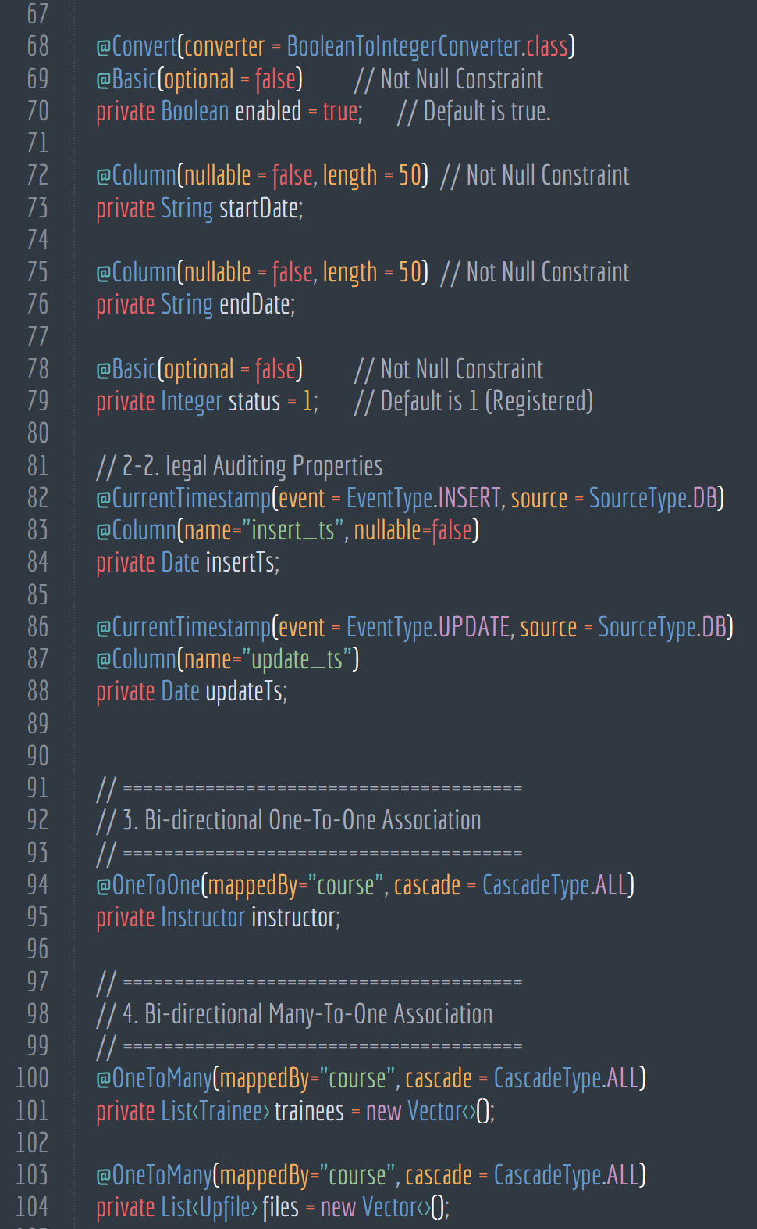
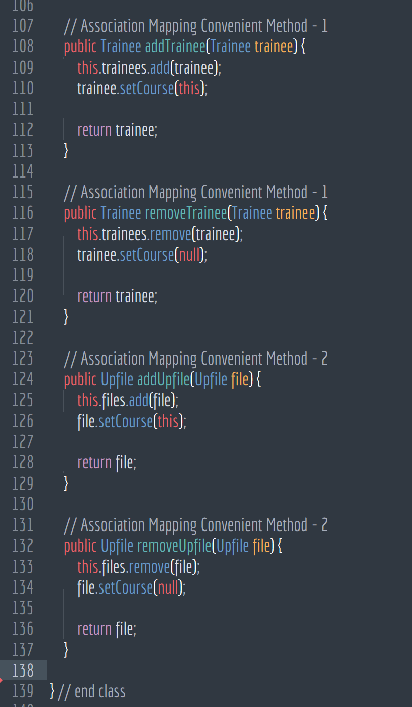
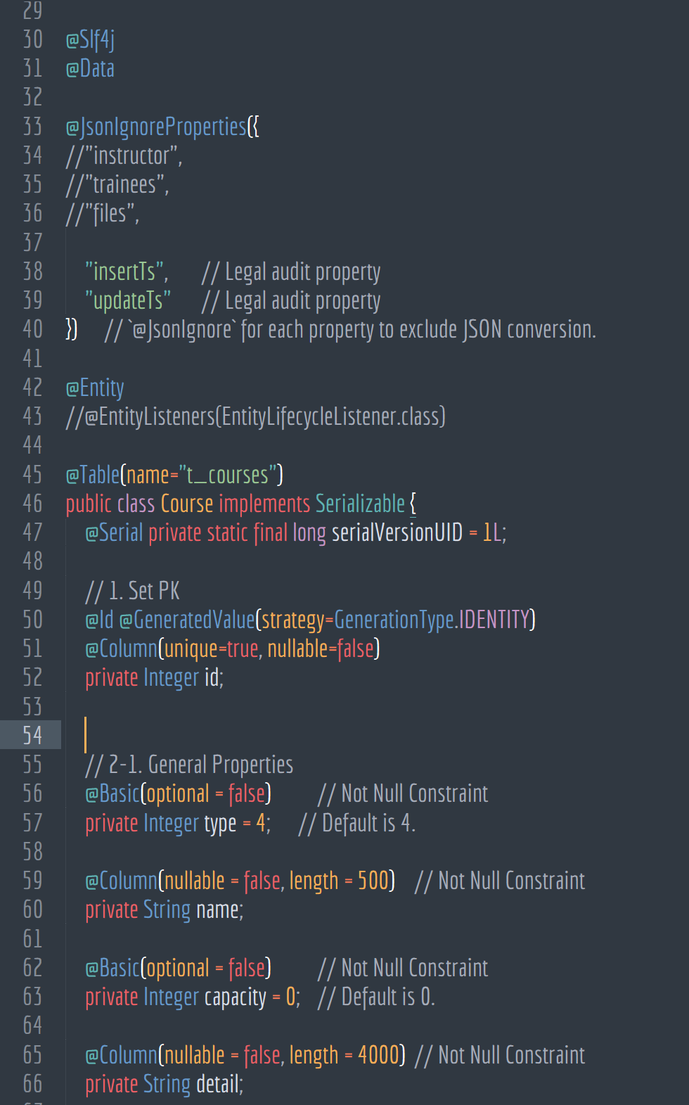
Core Sources_Back-End
Learning Management System
7-1. Entities - Course

Slide 62
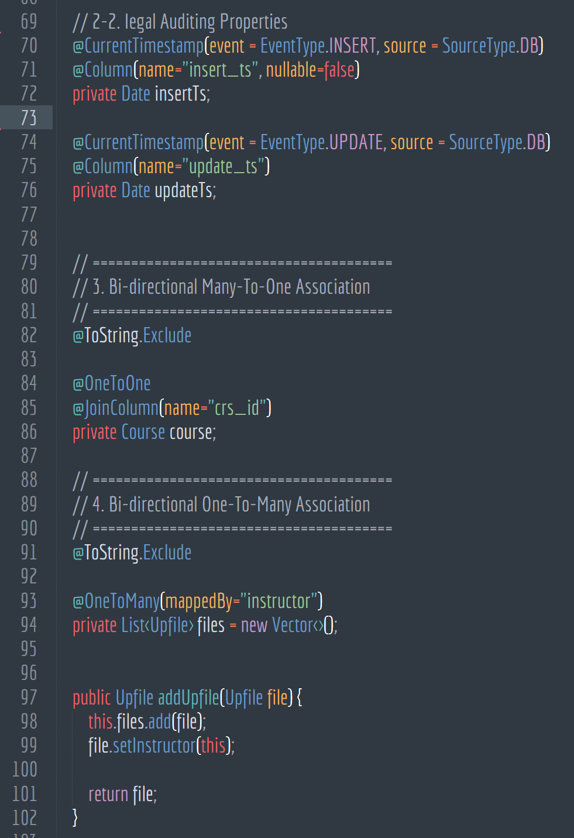
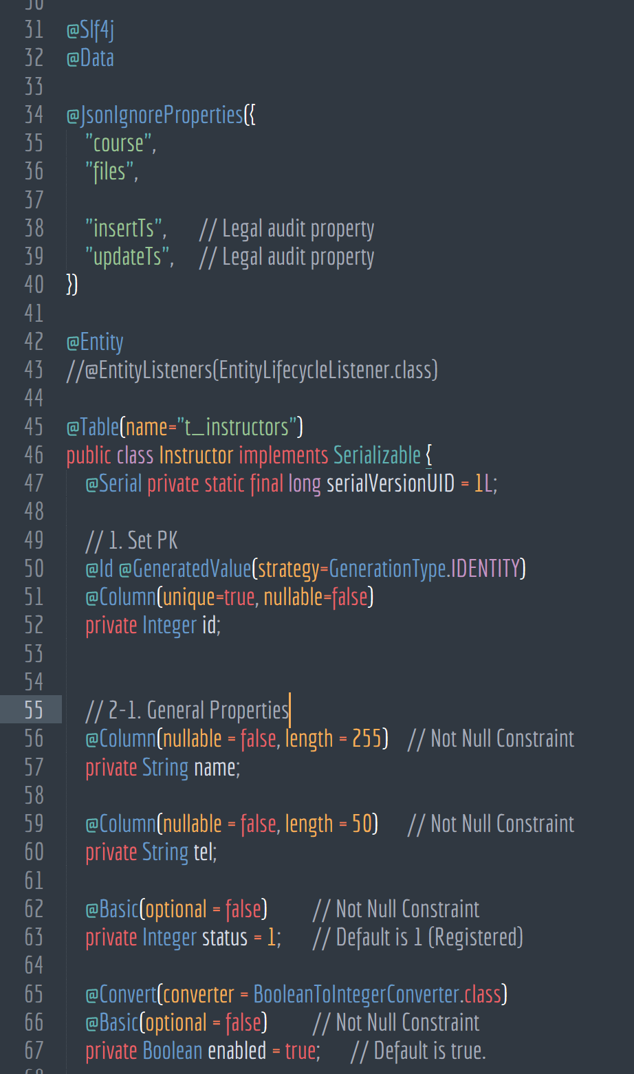
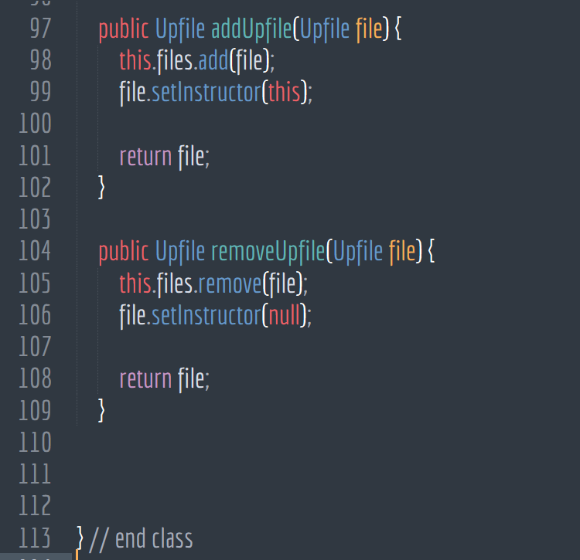
Core Sources_Back-End
Learning Management System
7-1. Entities - Instructor

Slide 63
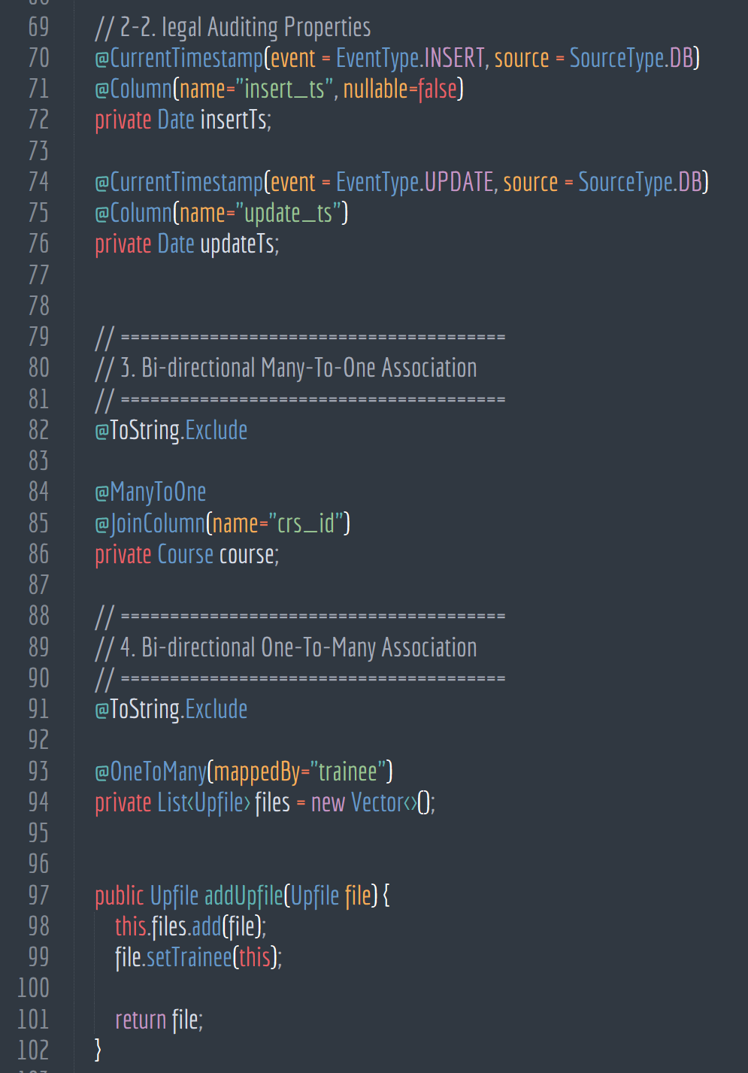
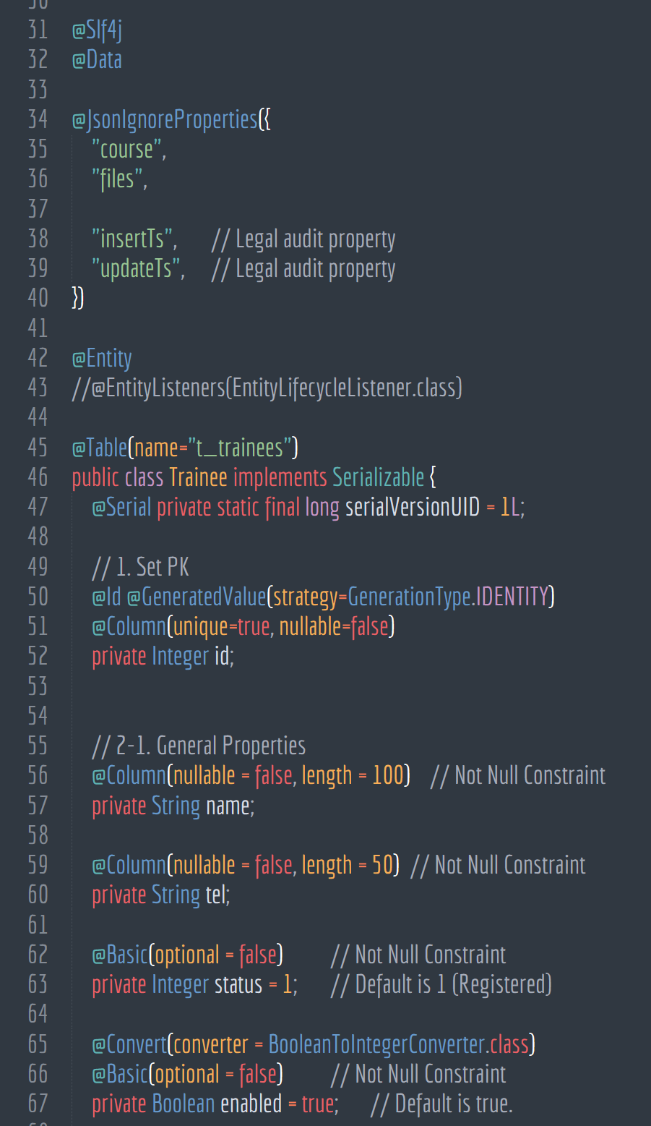
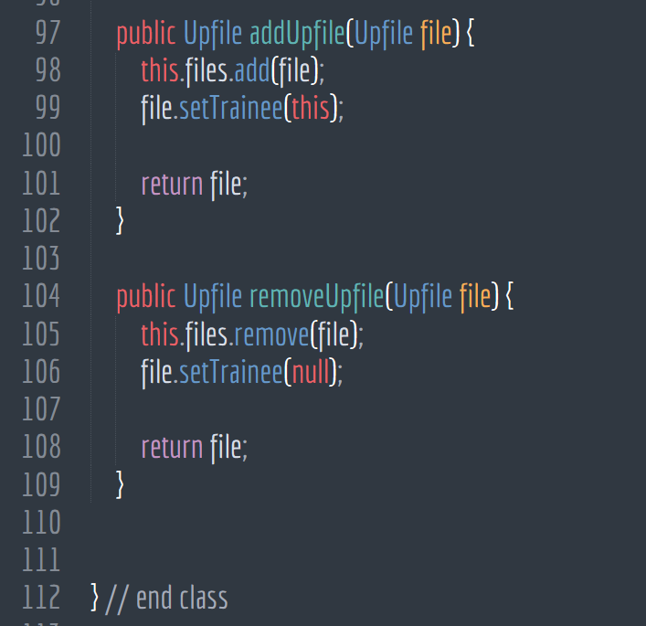
Core Sources_Back-End
Learning Management System
7-1. Entities - Trainee

Slide 64
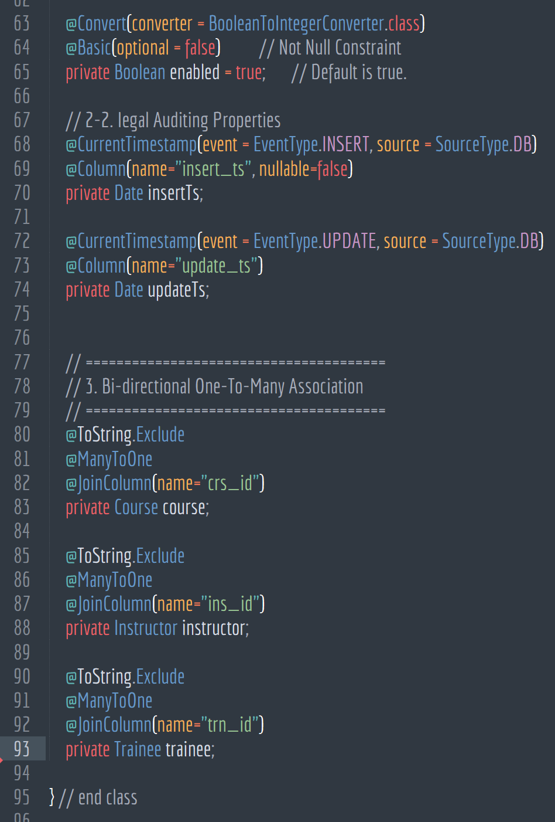
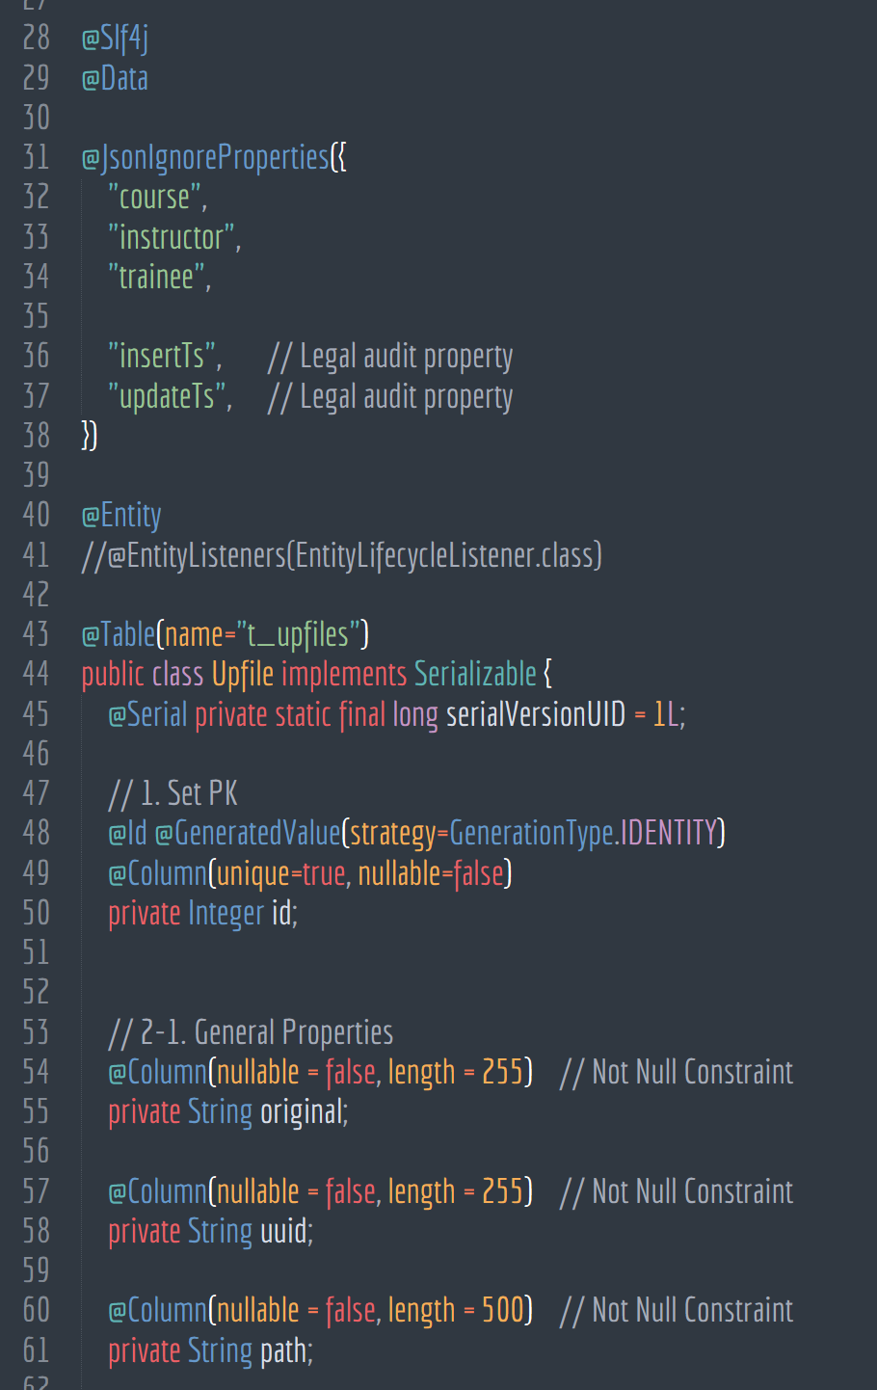
Core Sources_Back-End
Learning Management System
7-1. Entities - Upfile

Slide 65
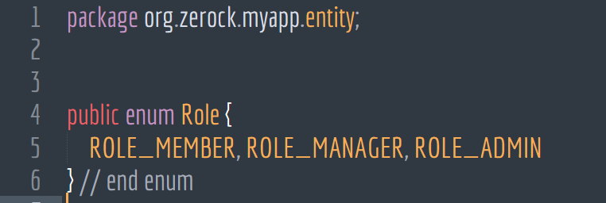
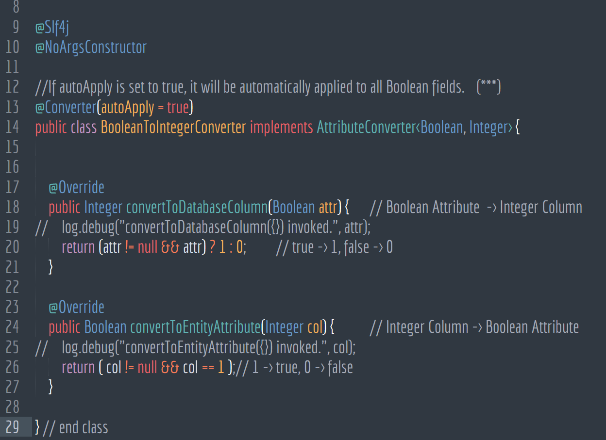
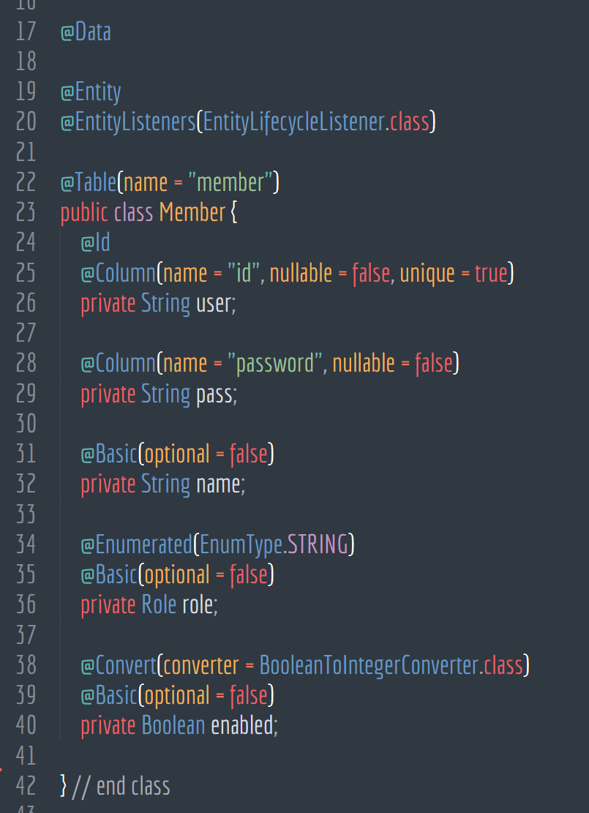
Core Sources_Back-End
Learning Management System
7-1. Entities - Member

Slide 66
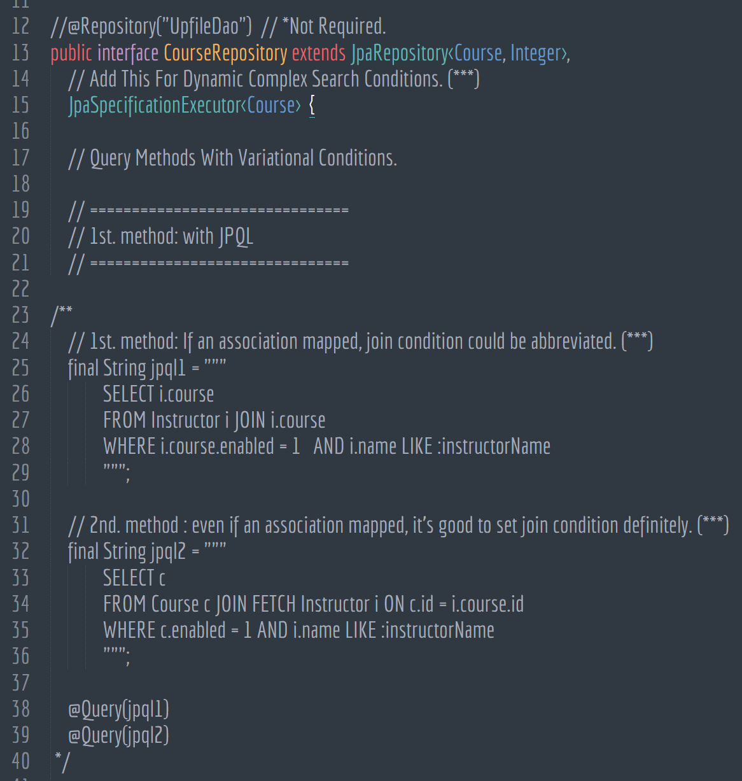
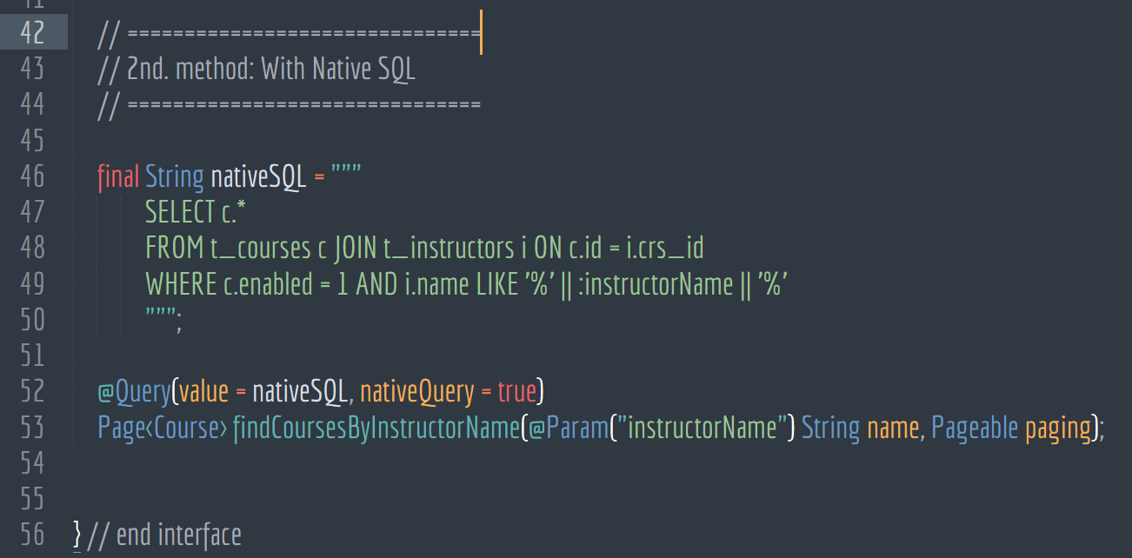
Core Sources_Back-End
Learning Management System
7-2. Repositories - Course Repository

Slide 67
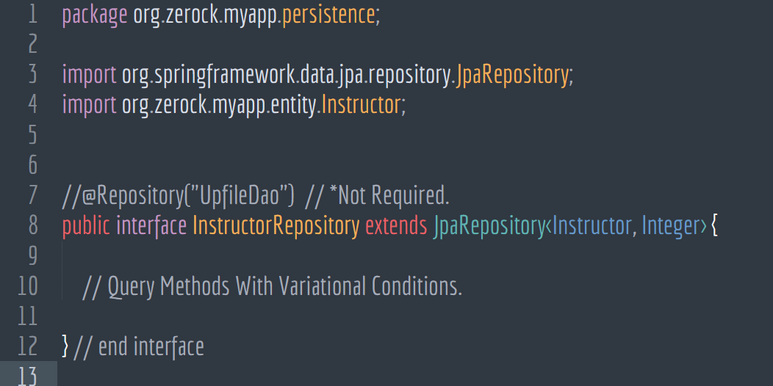
Core Sources_Back-End
Learning Management System
7-2. Repositories - Instructor Repository

Slide 68
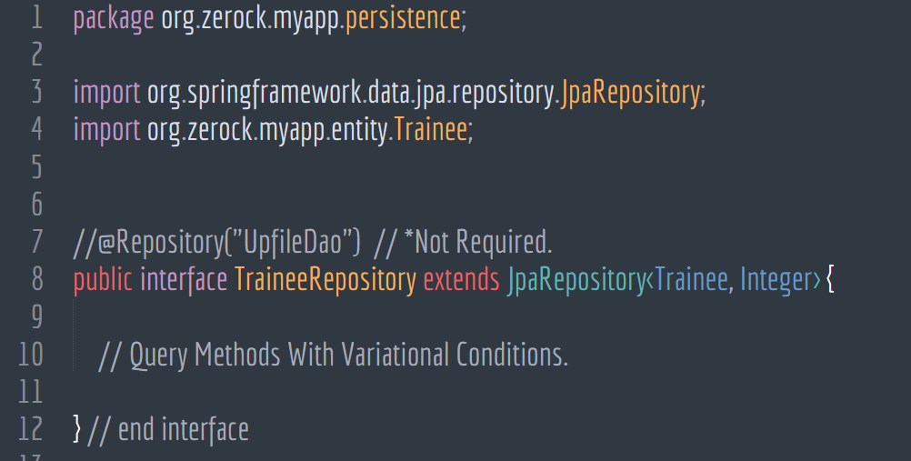
Core Sources_Back-End
Learning Management System
7-2. Repositories - trainee Repository

Slide 69
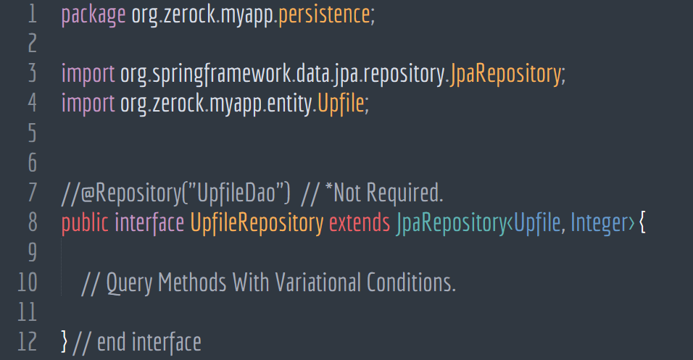
Core Sources_Back-End
Learning Management System
7-2. Repositories - file Repository

Slide 70
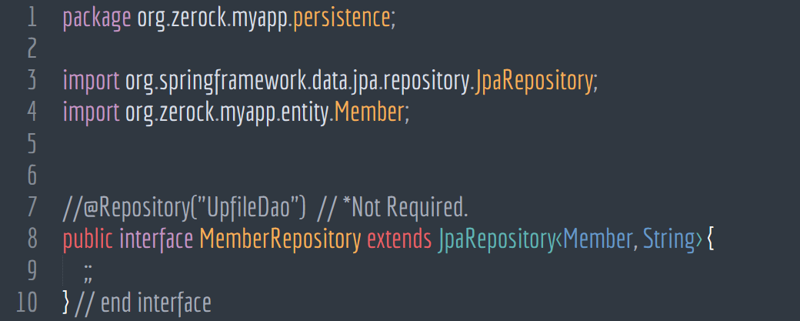
Core Sources_Back-End
Learning Management System
7-2. Repositories - Member Repository

Slide 71
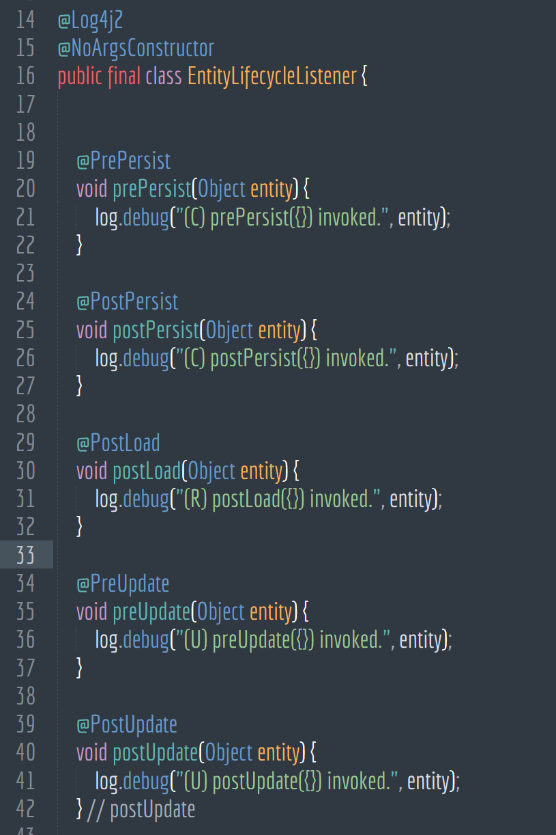
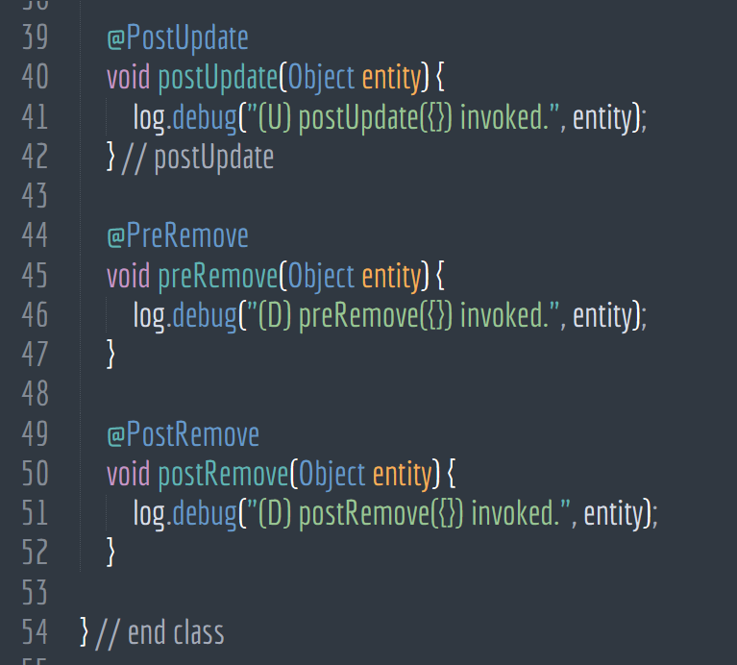
Core Sources_Back-End
Learning Management System
7-3. Entity Lifecycle Listener

Slide 72
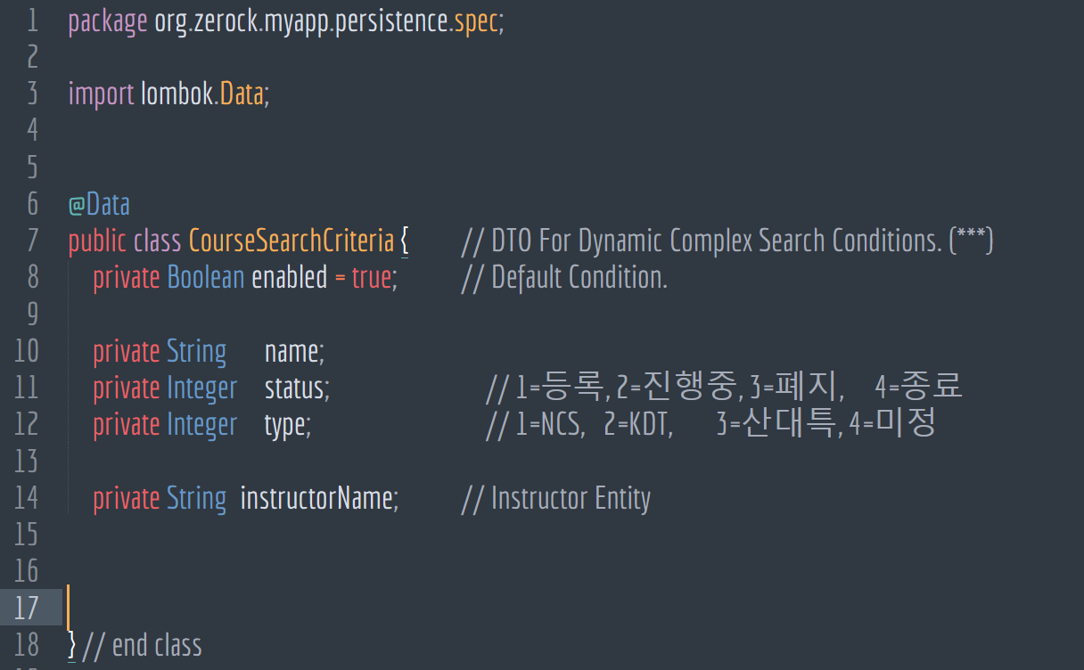
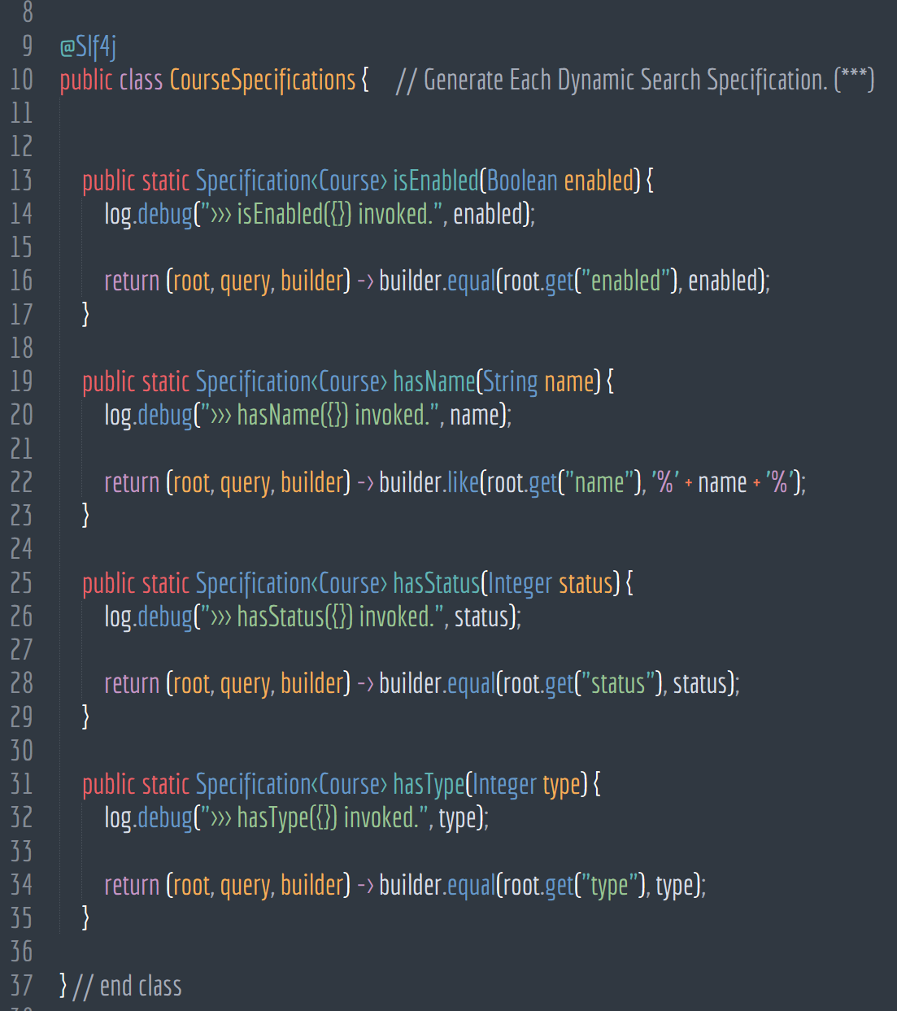
Core Sources_Back-End
Learning Management System
7-4. Complex Dynamic Search - Specifications

Slide 73



Core Sources_Back-End
Learning Management System
7-5. Rest Controller - Course Controller

Slide 74



Core Sources_Back-End
Learning Management System
7-5. Controller - Course Controller

Slide 75
Core Sources_Back-End
Learning Management System
7-5. Controller - Course Controller

Slide 76



Core Sources_Back-End
Learning Management System
7-6. Global Controller Exception Handler

Slide 77


Core Sources_Back-End
Learning Management System
7-7. Access Control (Spring Security)

Slide 78



Core Sources_Front-End
Learning Management System
7-8. React - Sign-In

Slide 79



Core Sources_Front-End
Learning Management System
7-9. React - Course

Slide 80




Core Sources_Front-End
Learning Management System
7-9. React - Course

Slide 81
Learning Management System
Project Demonstration

Slide 82





Learning Management System
PROJECT DEMONSTRATION
교육생 선발

Slide 83
Learning Management System
Q & A

Slide 84

LEARNING
MANAGEMENT
SYSTEM
감사합니다.

